Slide 1




USER INTERFACE PRESENTATION
Version 1.0

Slide 2

EmpowerU
Home
About Us
Information Kiosk
Contact
Login
At a Glance
Registration
Cash Transfer
Post Distribution Expenses
Admin
Summary
Area
Classification
Program Cycle
User
Report
Resource
Key facts
Import Logs

Slide 3

1
HOME

Slide 4

HOME
Empower U Cash+ portal

Slide 5
2
ABOUT US

Slide 6

ABOUT US
Navigate to the “About Us” module from the navigation panel.

Slide 7
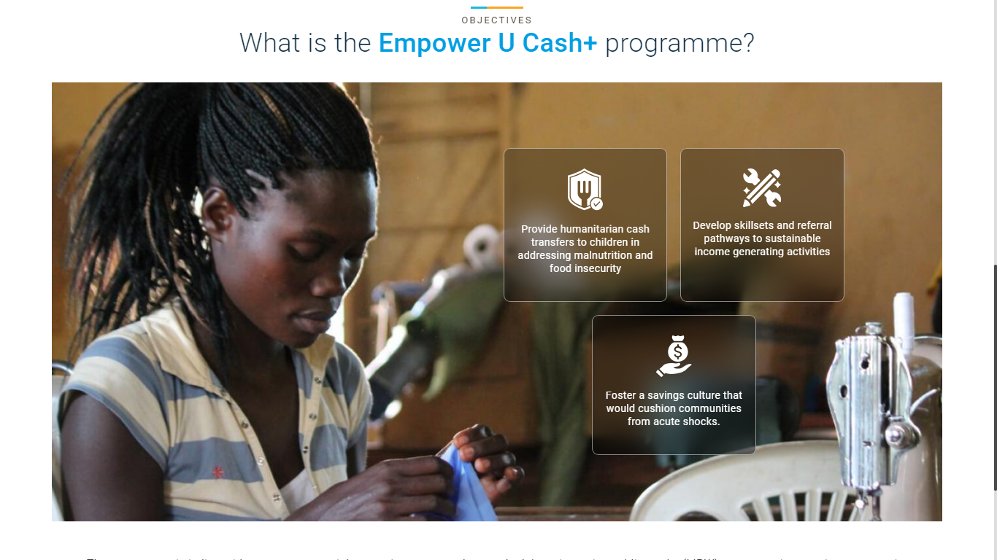
ABOUT US
Scroll down to read about the EmpowerU Cash+ programme.

Slide 8
3
INFORMATION KIOSK

Slide 9

INFORMATION KIOSK
Navigate to the “Information Kiosk” module from the navigation panel.

Slide 10
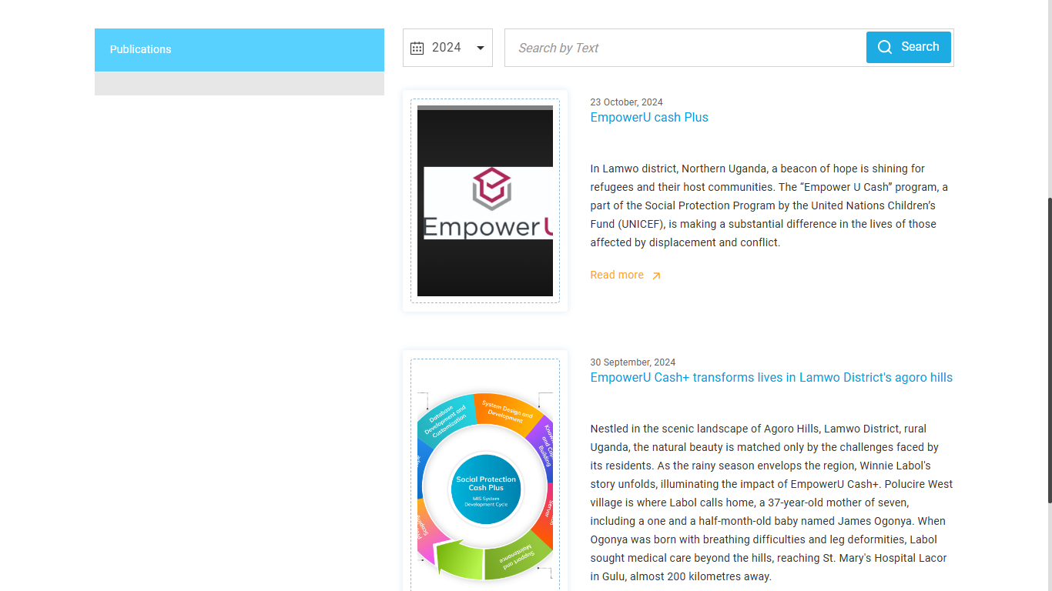
INFORMATION KIOSK
Search by year, name, or tags, then click the Search button to apply.

Slide 11
INFORMATION KIOSK
Click on the Read More button to read the description of the desired publication.

Slide 12
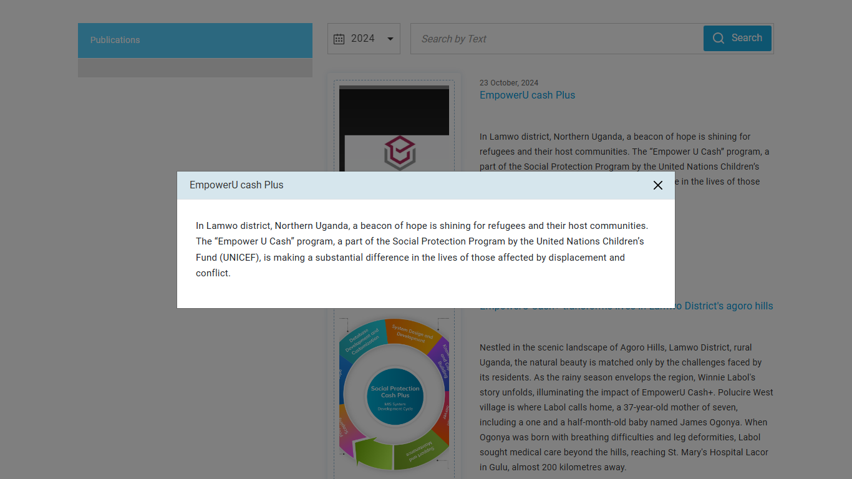
INFORMATION KIOSK
Description of the selected Publication.

Slide 13
4
CONTACT US

Slide 14

CONTACT
Navigate to the “Contact” module from the navigation panel.

Slide 15
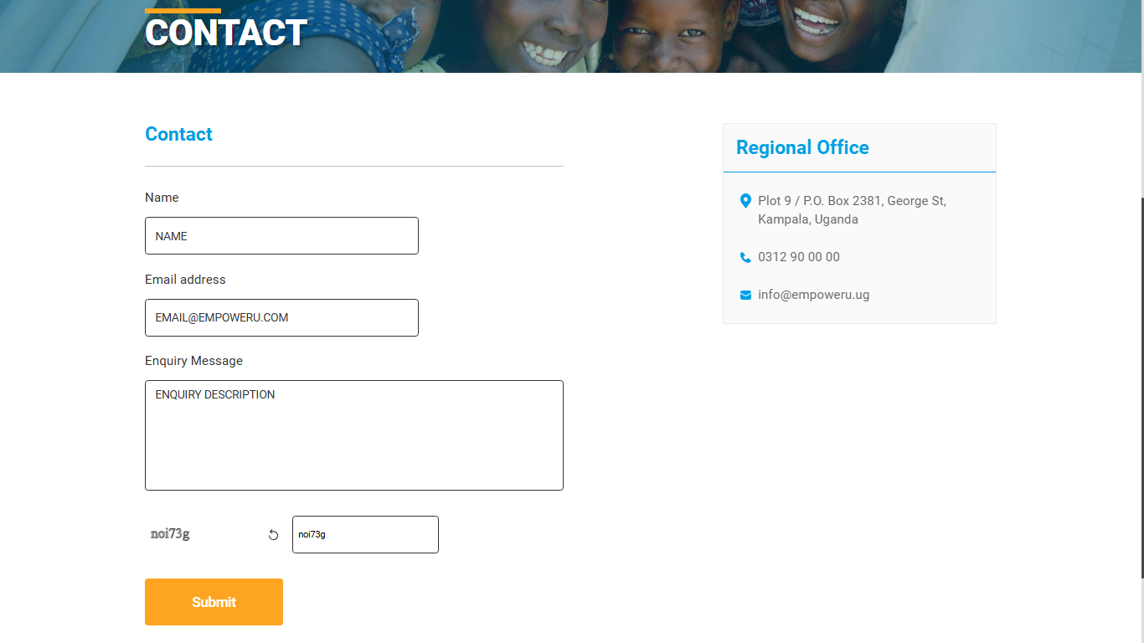
CONTACT
Fill in mandatory details and enter CAPTCHA, then click the Submit button.

Slide 16
CONTACT
View the Regional office address, phone number, and email.

Slide 17
5
LOGIN

Slide 18
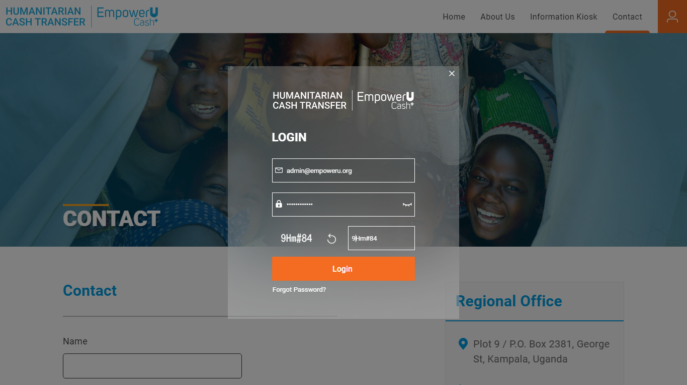
LOGIN
To login, click the User button from the navigation panel.

Slide 19
LOGIN
Enter email address, password and CAPTCHA to login.

Slide 20
5
LOGIN–
At A GLANCE

Slide 21
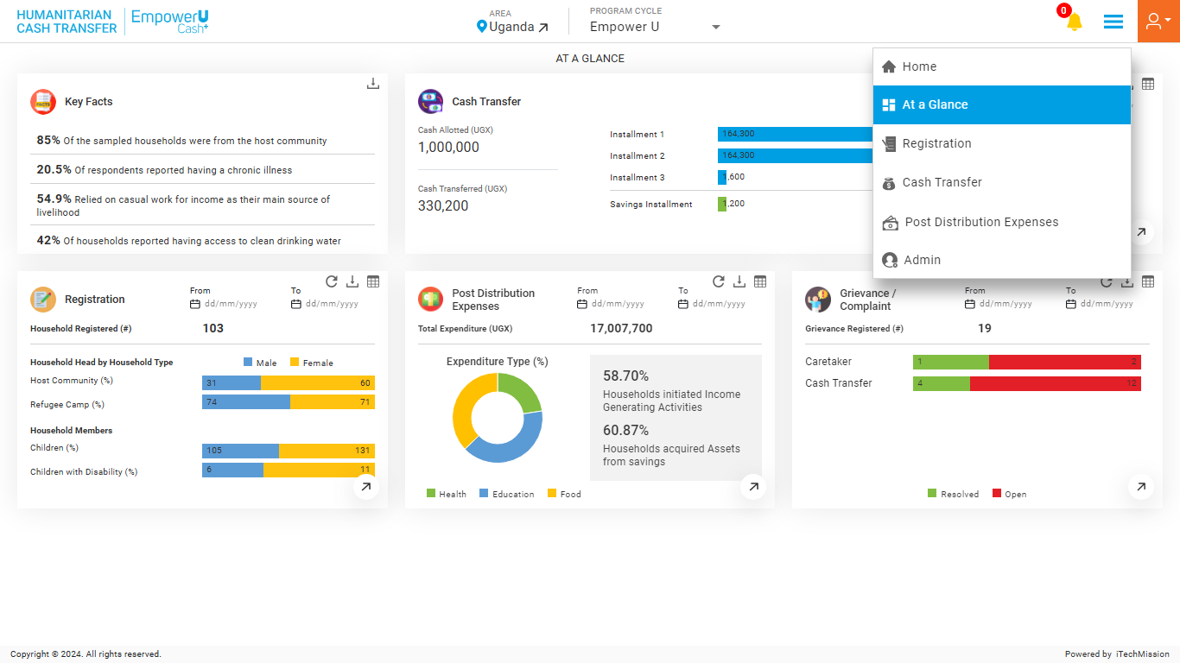
AT A GLANCE
Navigate to the “At a glance” module from the burger menu.

Slide 22
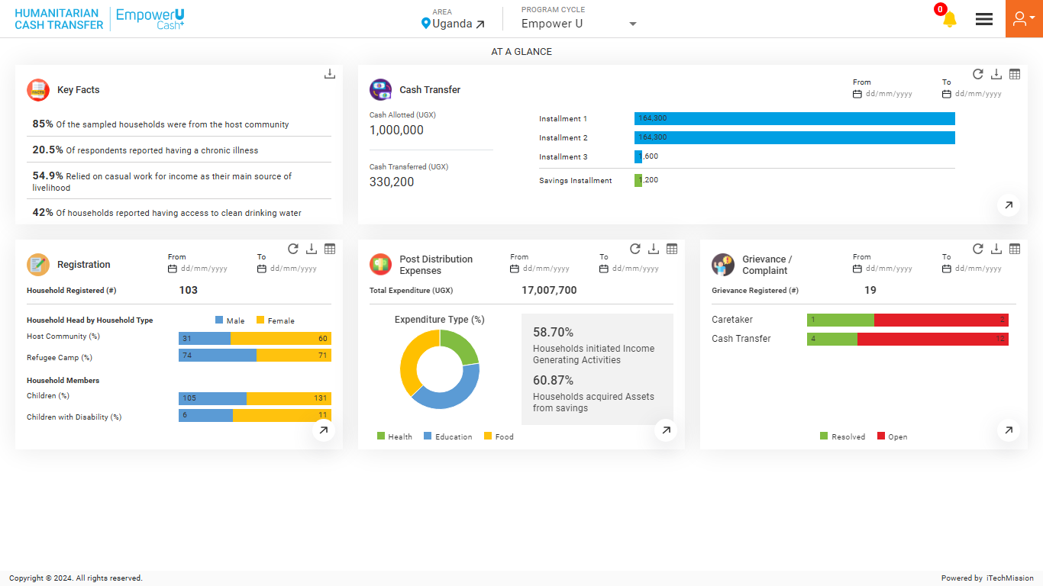
AT A GLANCE
View Key Facts and summarized data about – Cash Transfer, Registration, Post Distribution Expenses, and Grievance/Complaints.

Slide 23
AT A GLANCE
Filter Data by Time Period.

Slide 24
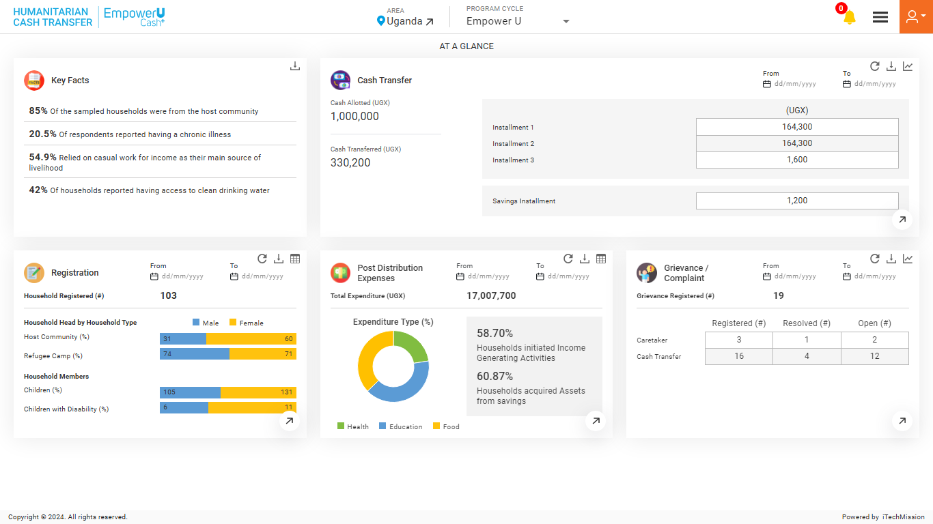
AT A GLANCE
Download the current display from the Widget.

Slide 25
AT A GLANCE
View count of Registered, Resolved and Open Grievances

Slide 26
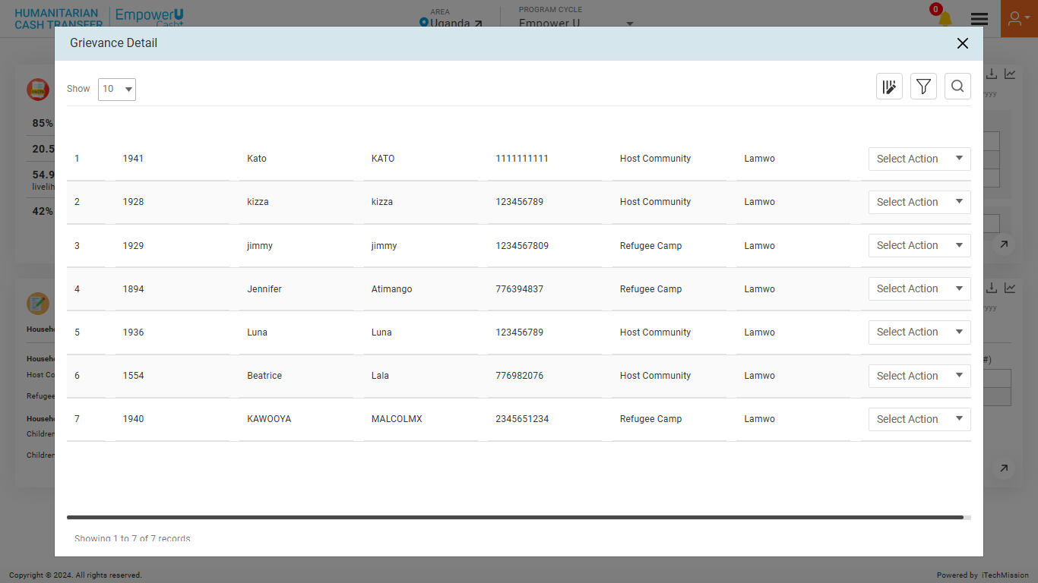
AT A GLANCE
View Grievance List.

Slide 27
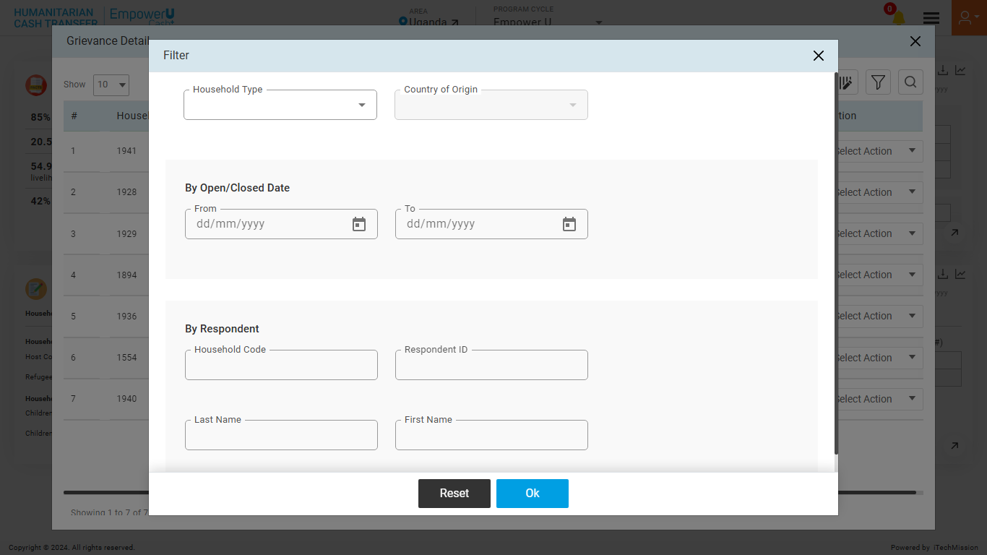
AT A GLANCE
Filter Grievance list. Click the OK button to apply.

Slide 28
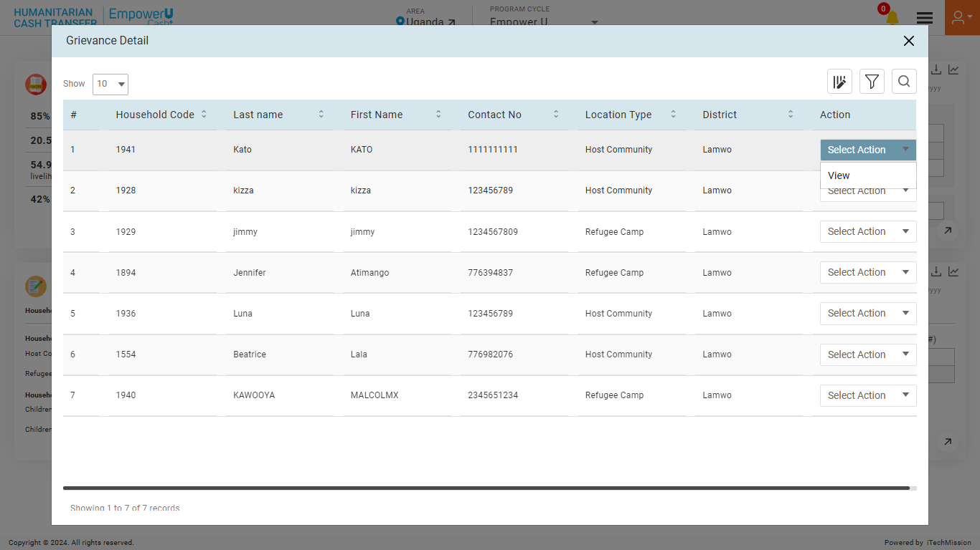
AT A GLANCE
View the select Household data.

Slide 29
5
LOGIN– REGISTRATION

Slide 30
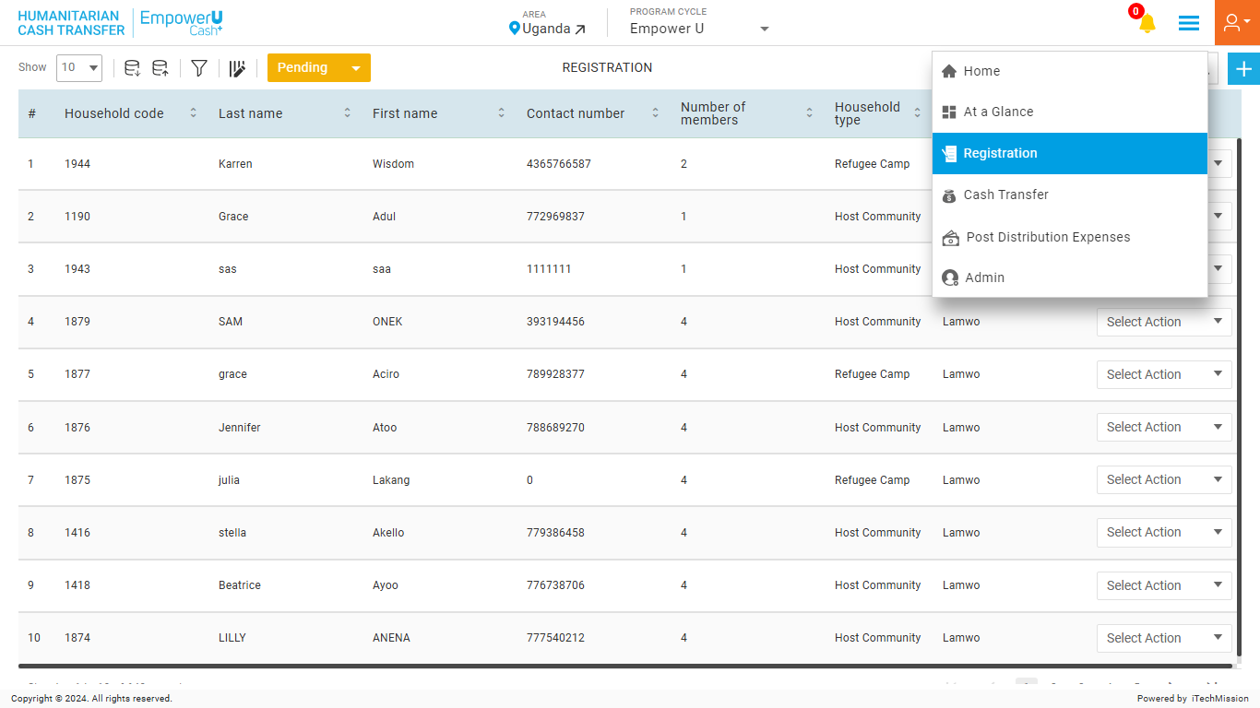
REGISTRATION
Navigate to the “Registration” module from the burger menu.

Slide 31
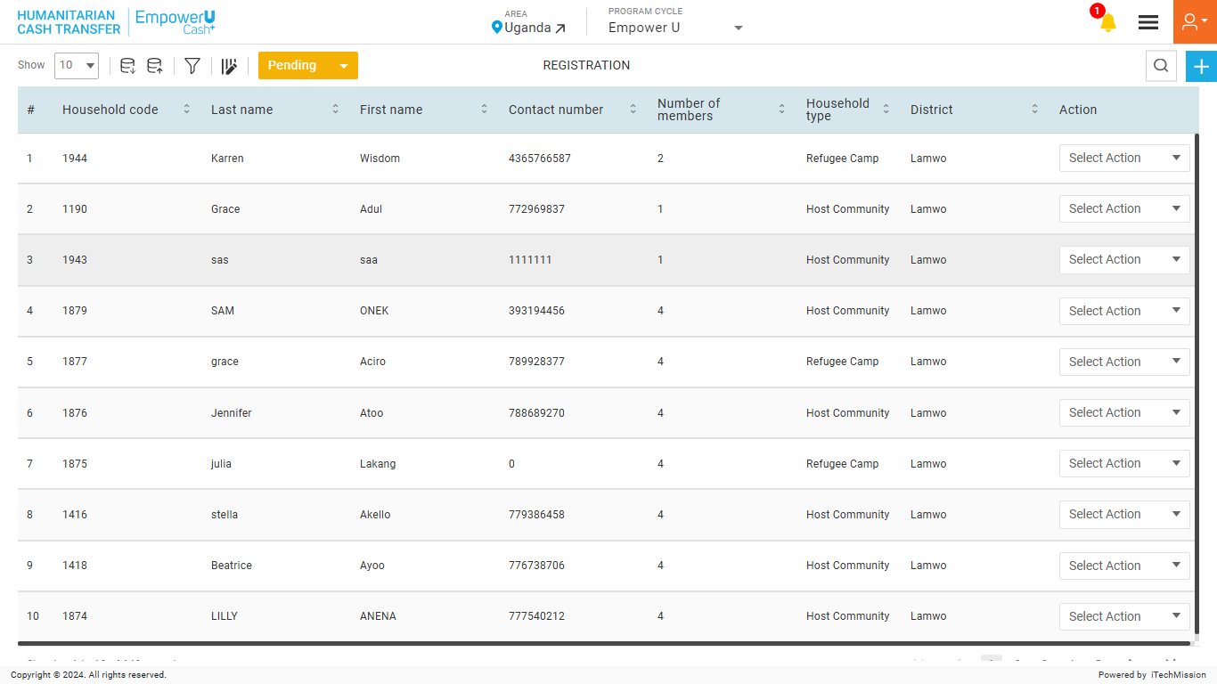
REGISTRATION
Select the Area to view the area-specific household list.

Slide 32
REGISTRATION
Click on the Plus button to add a new Household.

Slide 33
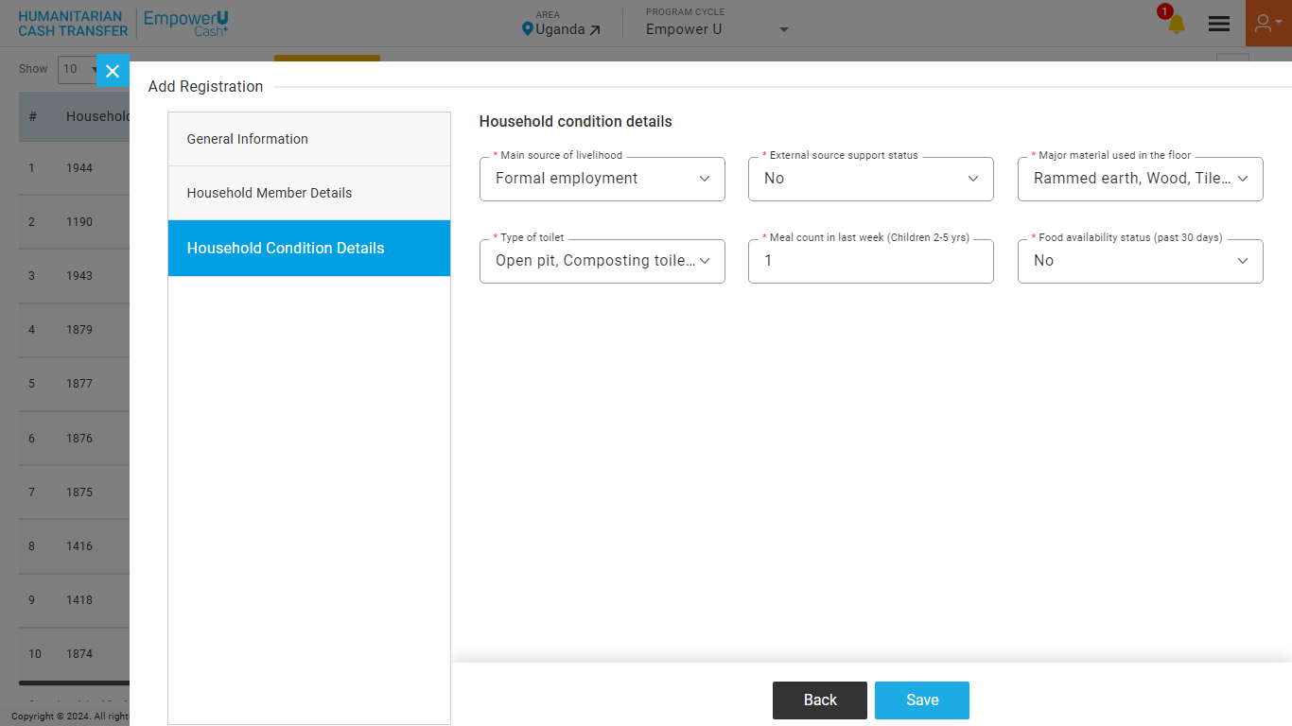
REGISTRATION
Enter the mandatory details and click on the Add button to confirm.

Slide 34
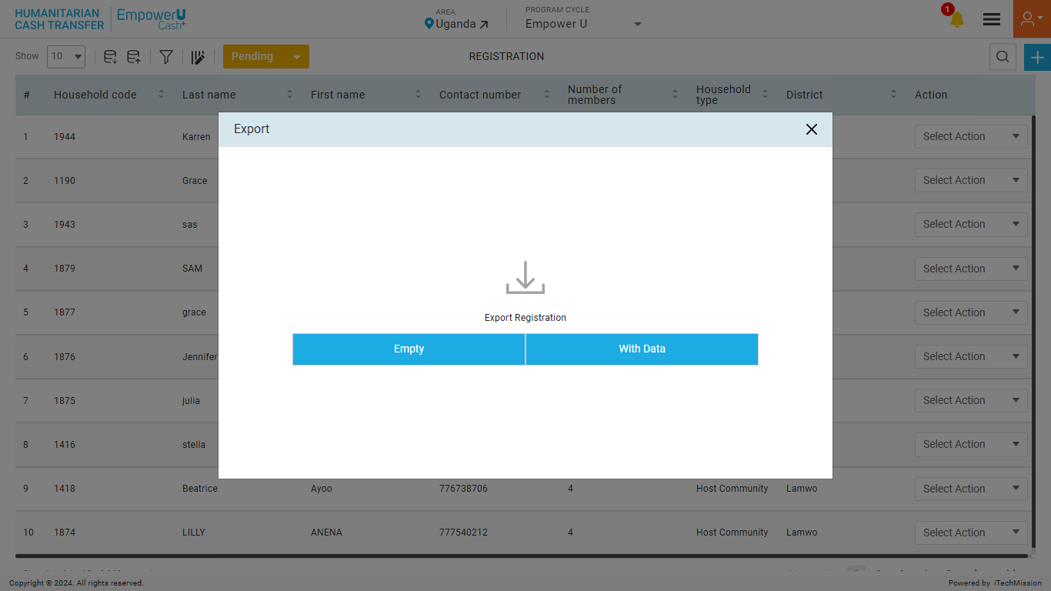
REGISTRATION
To export, click on Empty to download the Empty Template or click on With Data to download existing Households.

Slide 35
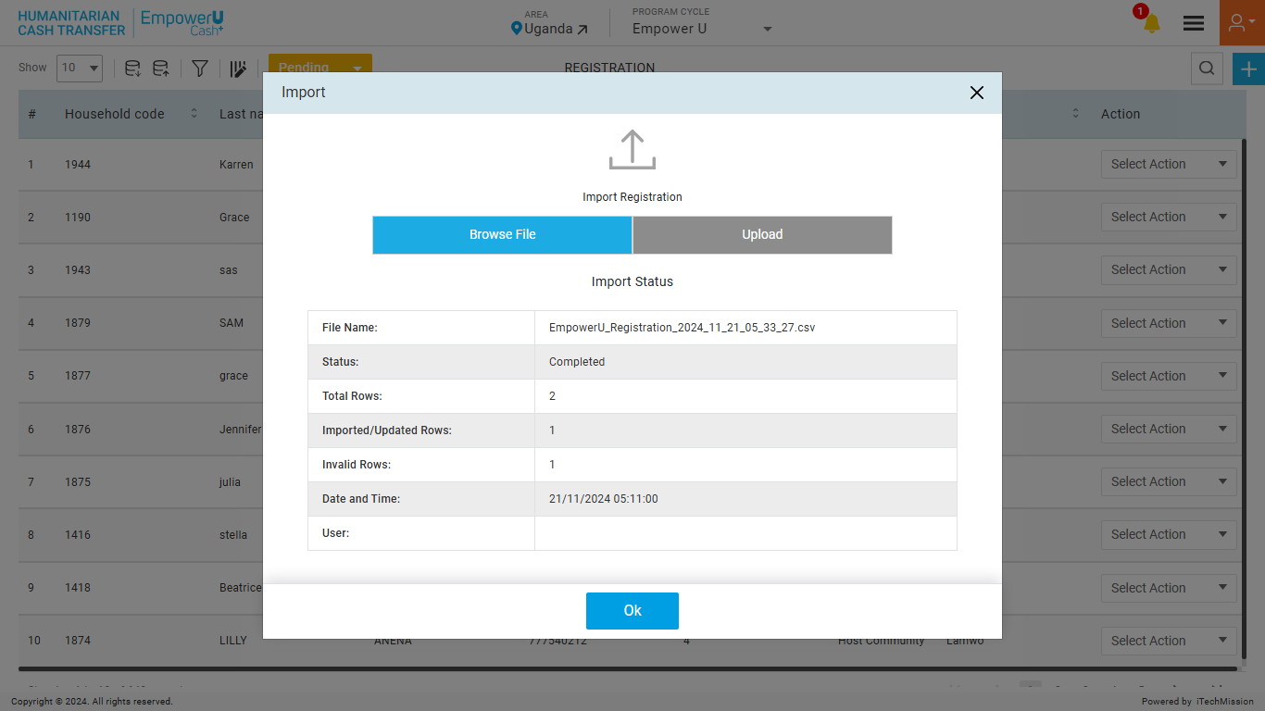
REGISTRATION
To import, browse the file and click the Upload button to start the import process. Click on the OK button to confirm.

Slide 36
REGISTRATION
View the Last Import Summary once the import process is completed.

Slide 37
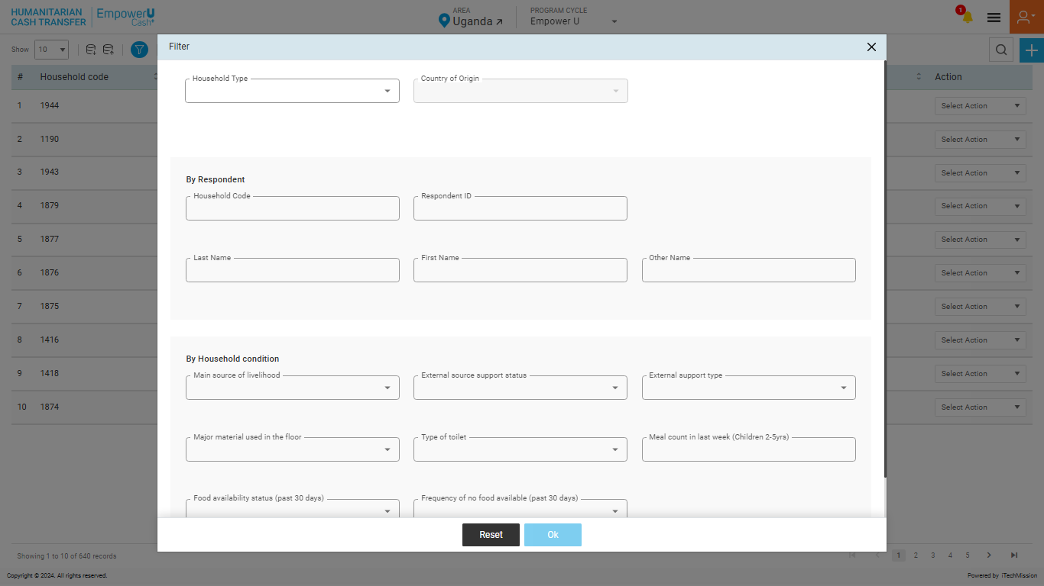
REGISTRATION
Filter Pending Household List. Click the OK button to apply.

Slide 38
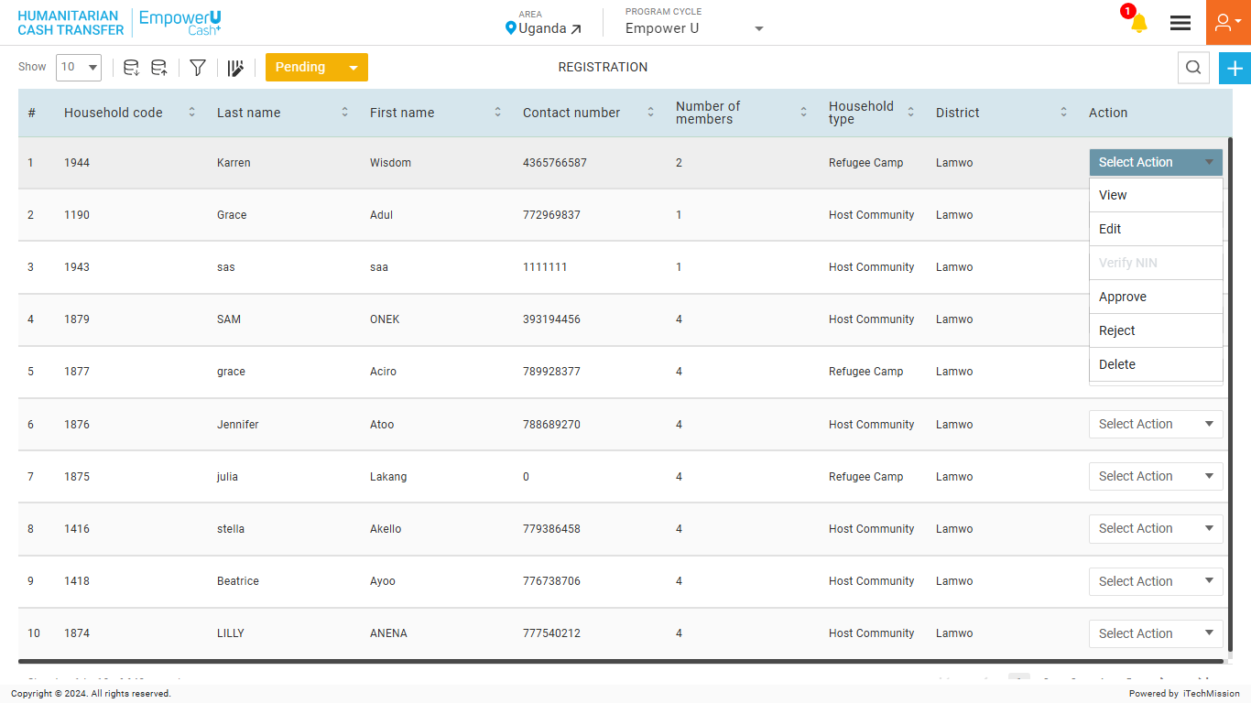
REGISTRATION
View, Edit, Approve, Reject, and Delete the Pending Household.

Slide 39
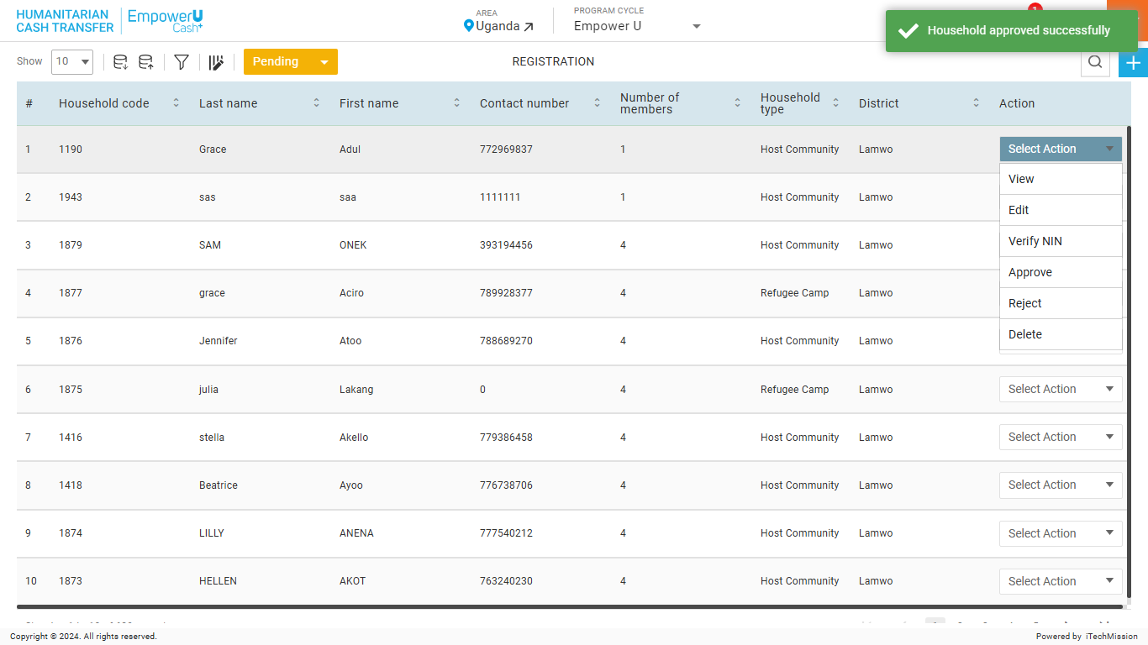
REGISTRATION
Approve the selected Household in the Pending state.

Slide 40
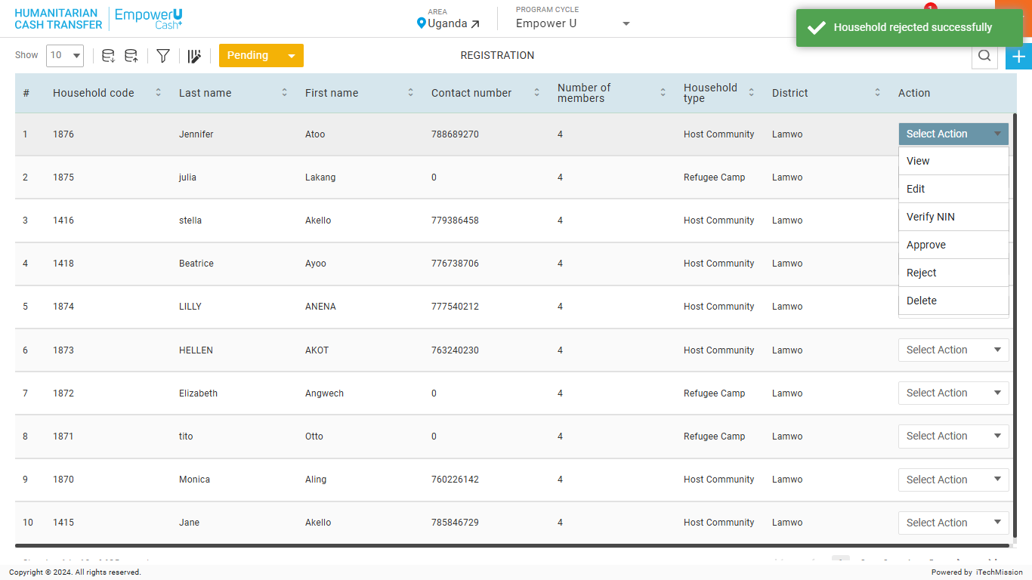
REGISTRATION
Reject the selected Household in the Pending state.

Slide 41
REGISTRATION
Delete the selected Household in the Pending state.

Slide 42
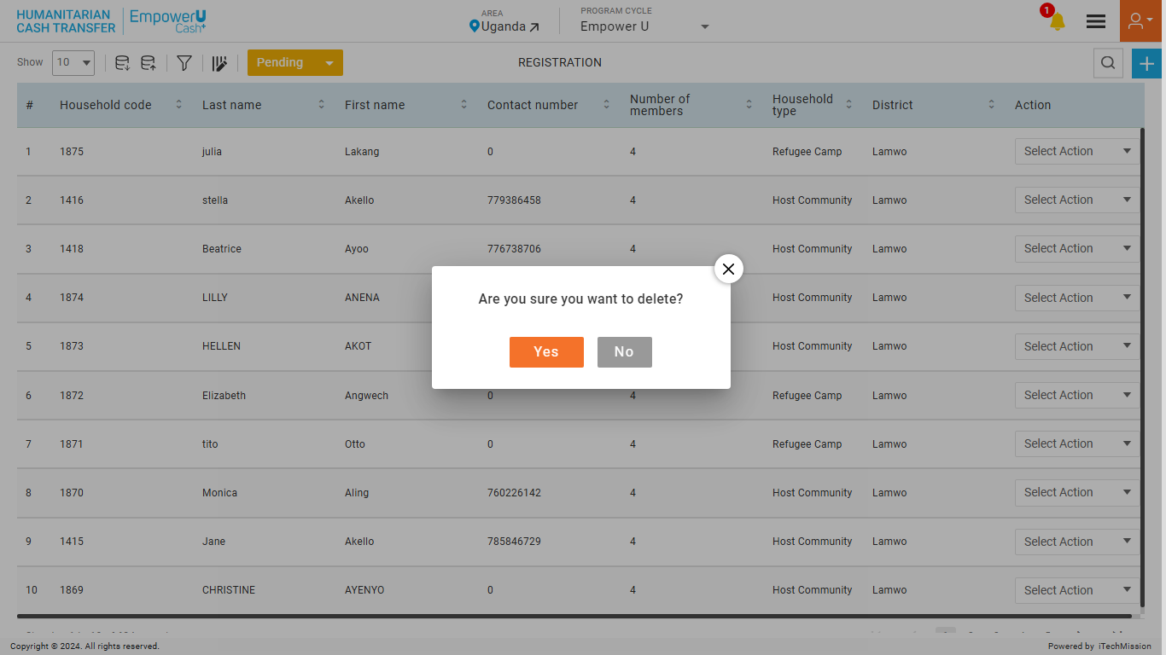
REGISTRATION
Click the Yes button to confirm deletion.

Slide 43
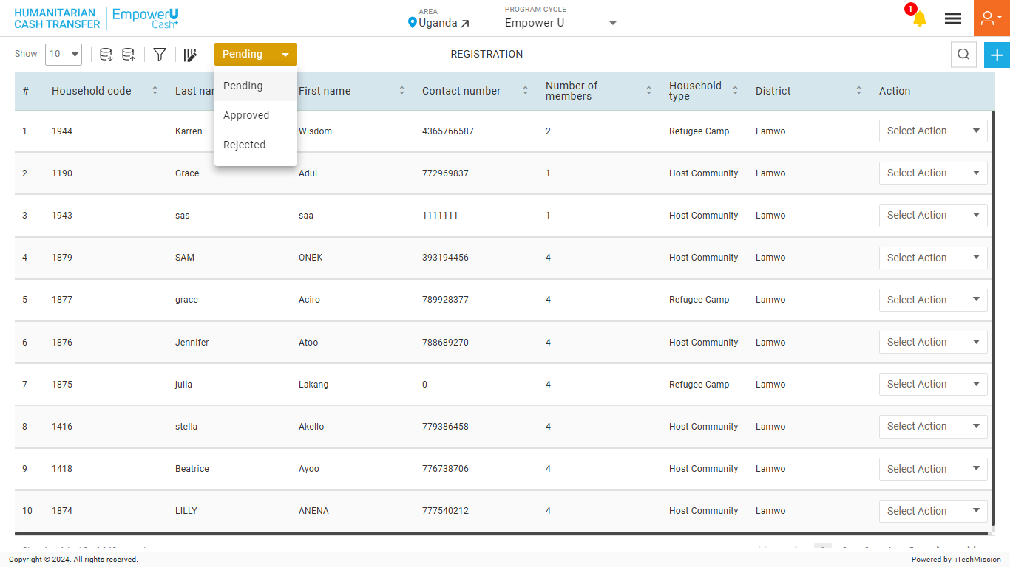
REGISTRATION
Select from the Status dropdown to view and edit the Approved or Rejected Household list.

Slide 44
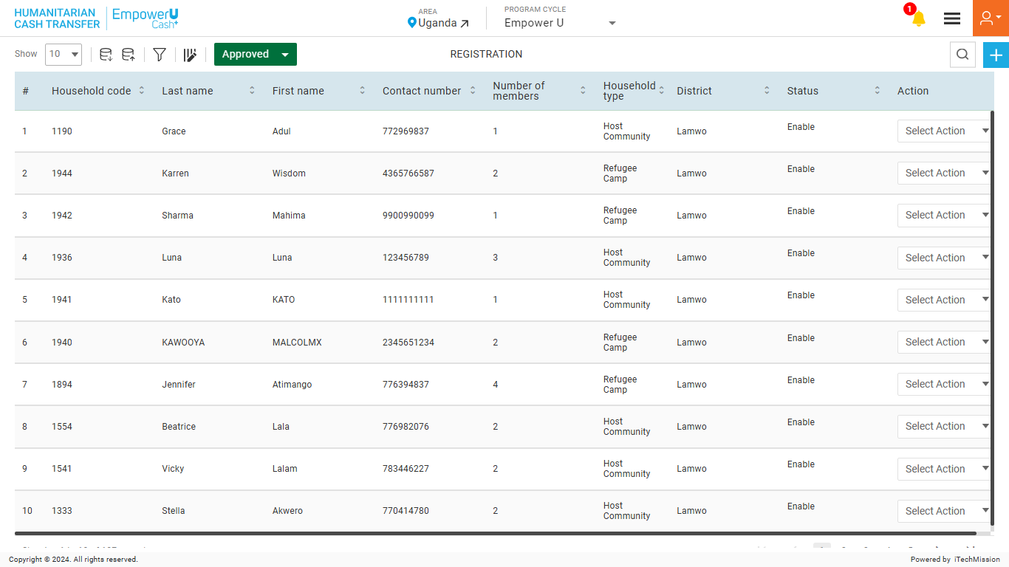
REGISTRATION
Approved Household List.

Slide 45
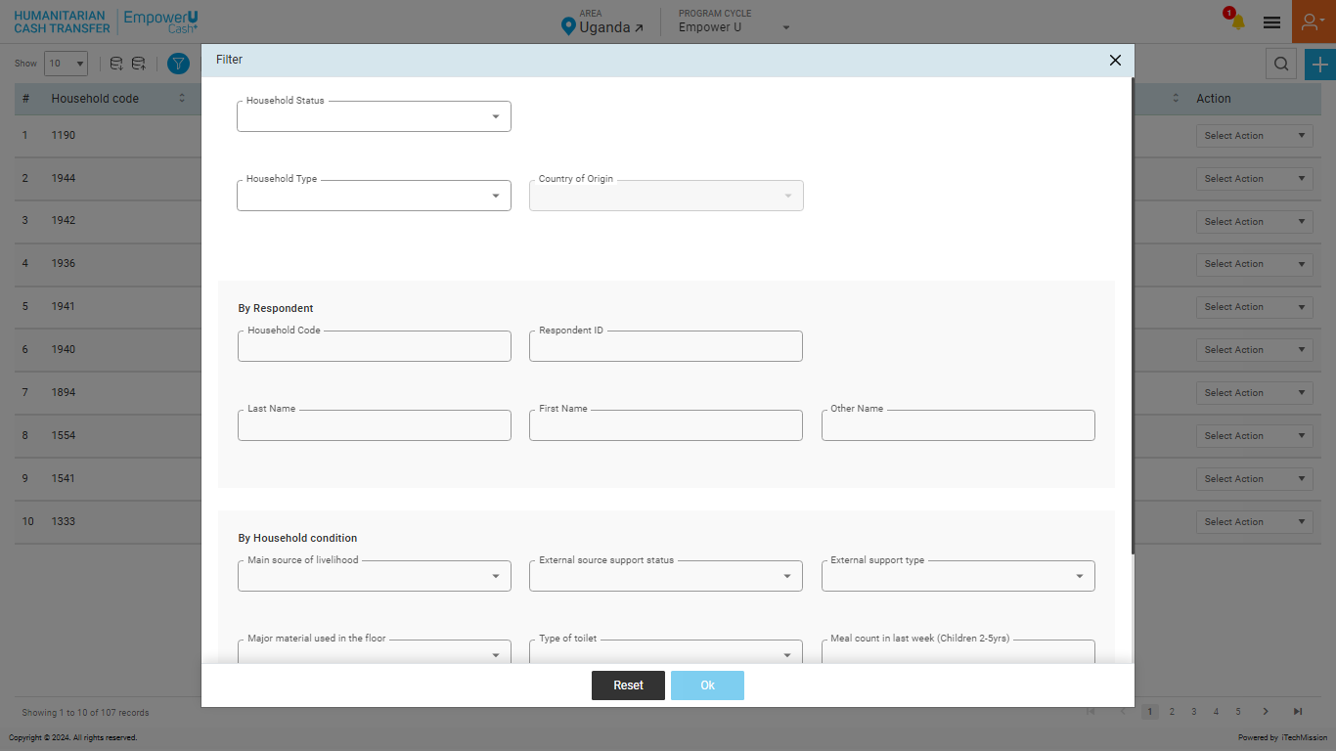
REGISTRATION
Filter Approved Household List. Click the OK button to apply.

Slide 46
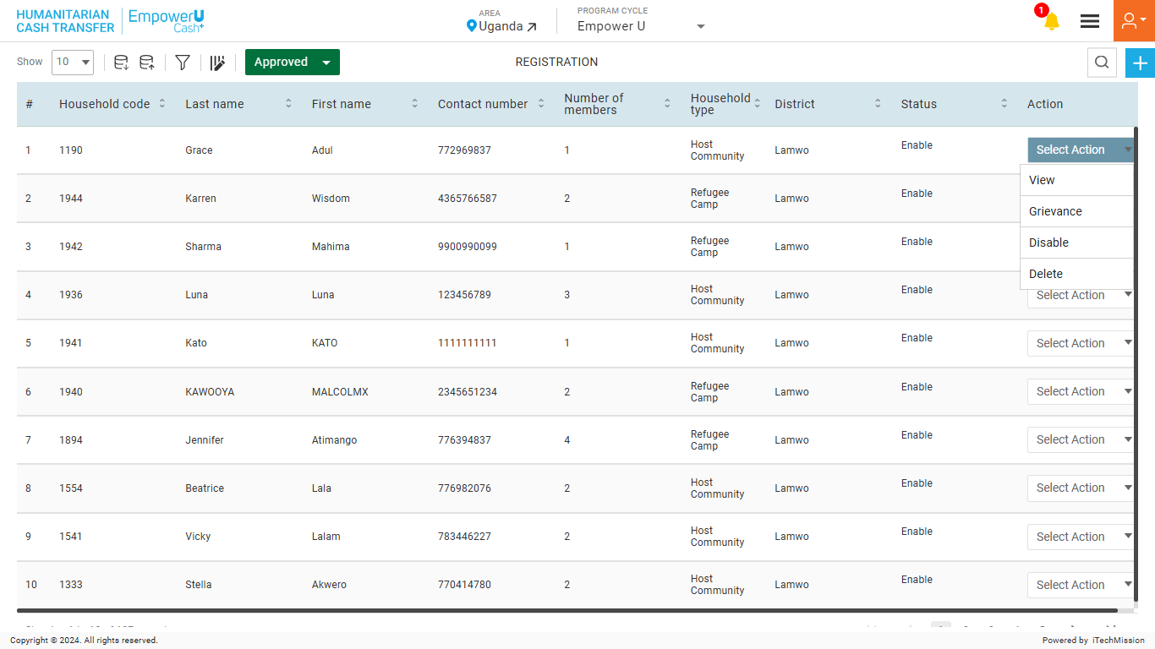
REGISTRATION
View, Grievance, Enable/Disable, and Delete the Approved Household.

Slide 47
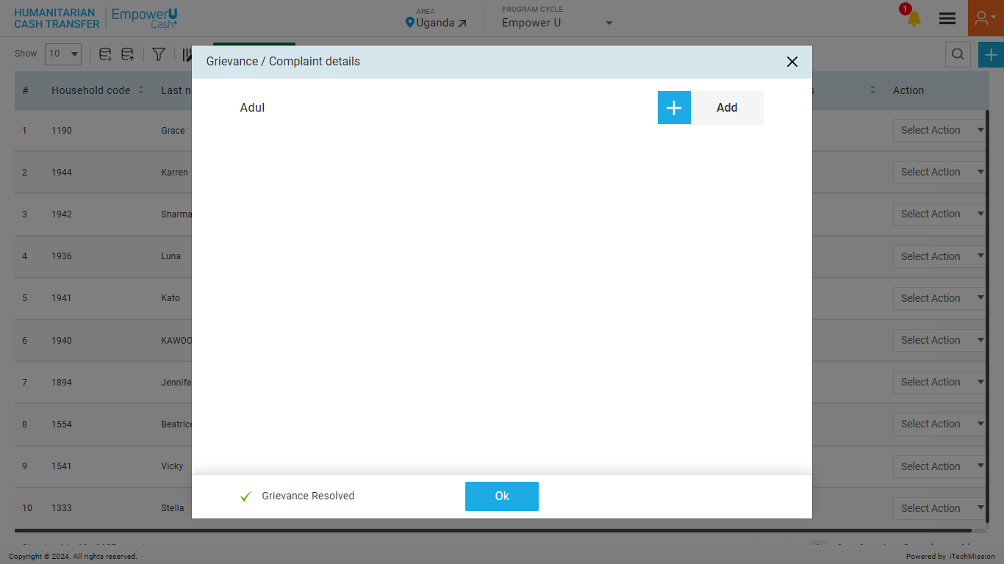
REGISTRATION
Click on Add button to add a grievance.

Slide 48
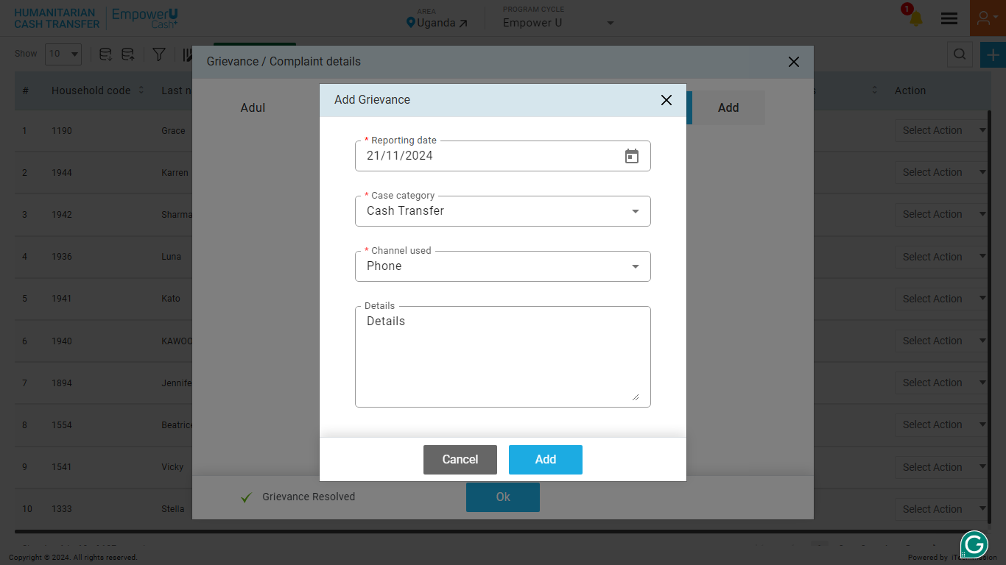
REGISTRATION
Enter the mandatory details and click on the Add button to confirm.

Slide 49
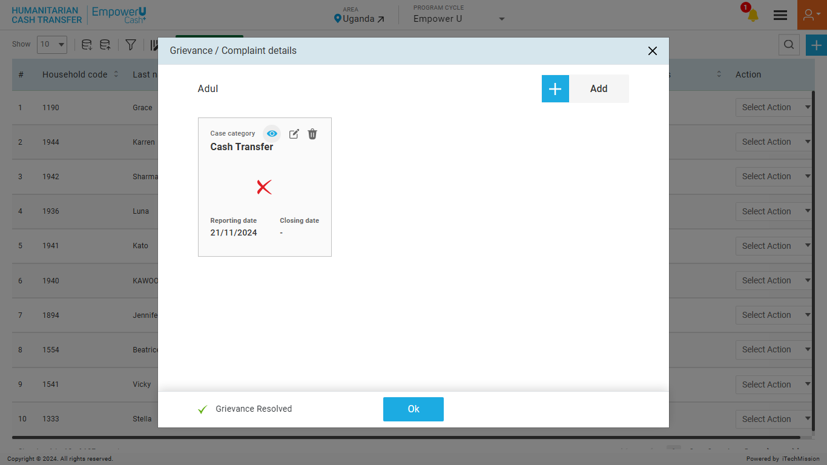
REGISTRATION
View, Edit, And Delete Grievance/Complaint Details.

Slide 50
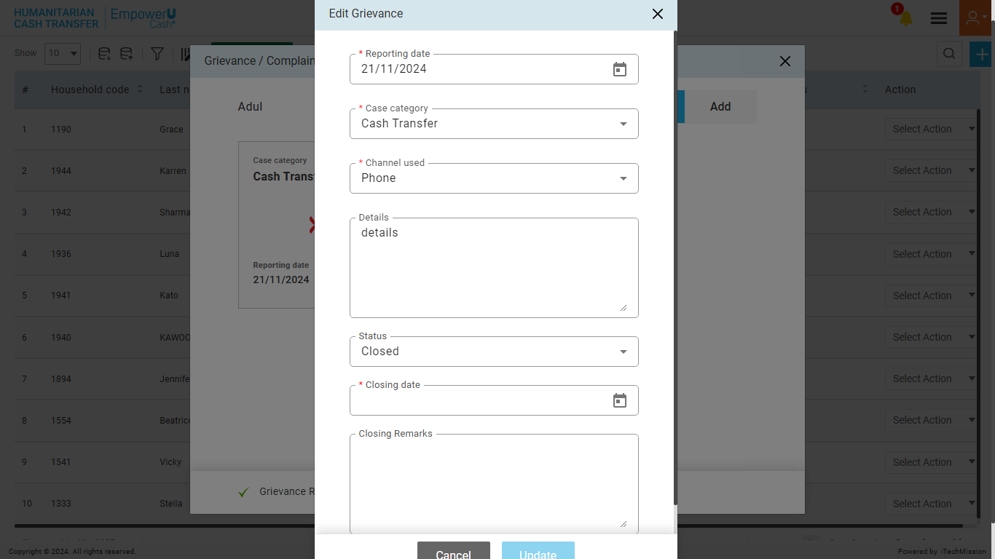
REGISTRATION
Edit the details of a grievance and update the status.

Slide 51
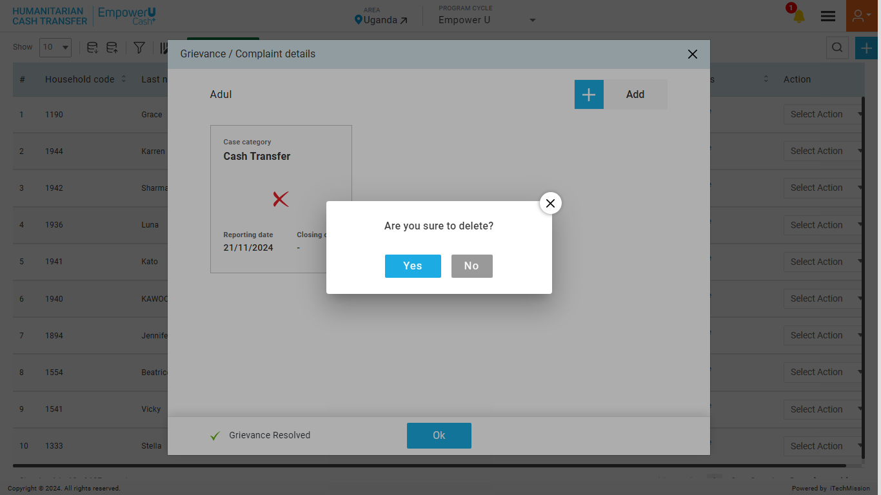
REGISTRATION
Click the Yes button to confirm grievance deletion.

Slide 52
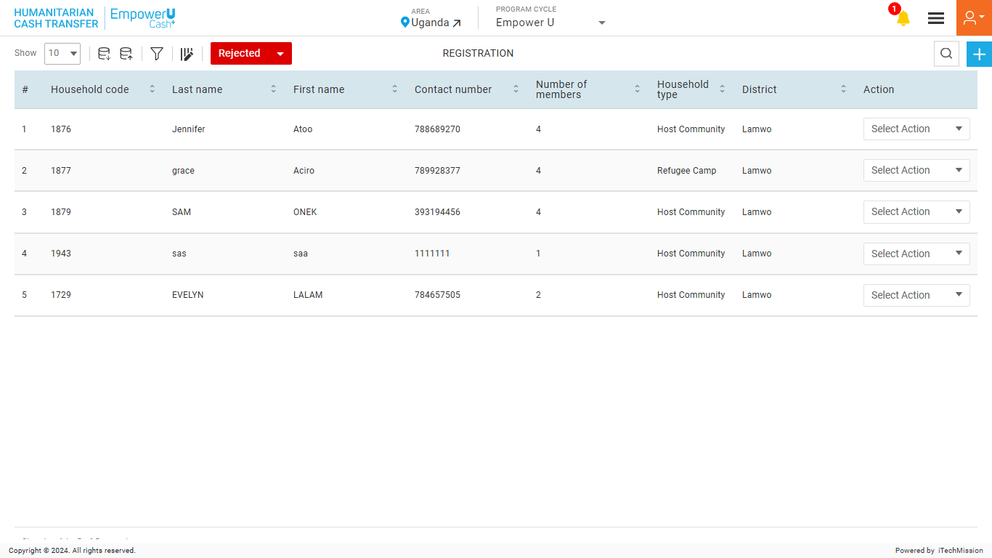
REGISTRATION
Rejected Household List.

Slide 53
REGISTRATION
Filter Rejected Household List. Click the OK button to apply.

Slide 54
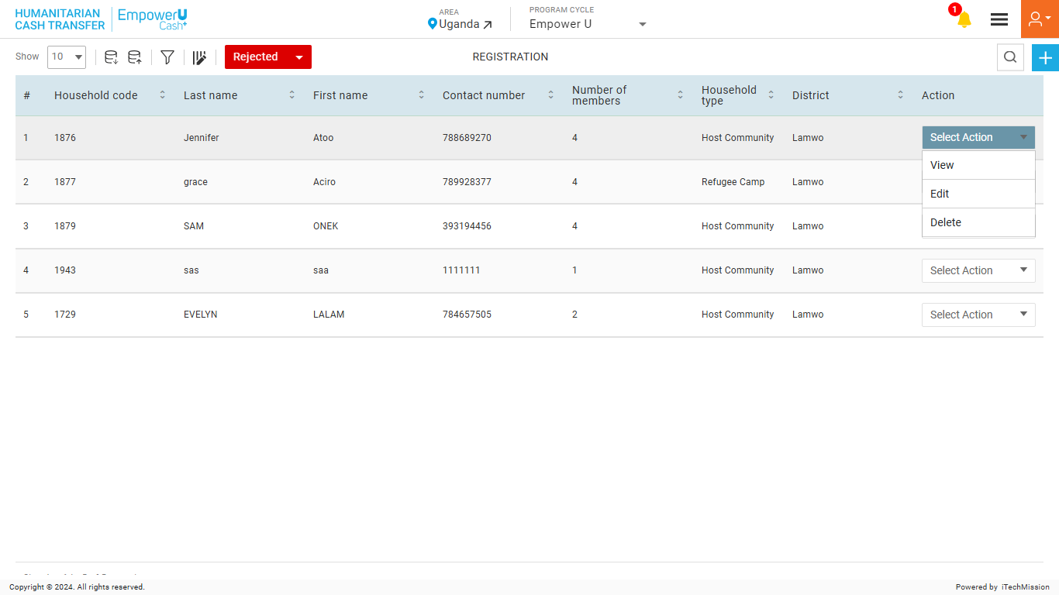
REGISTRATION
View, Edit, and Delete the Rejected Household.

Slide 55
5
LOGIN–
CASH TRANSFER

Slide 56
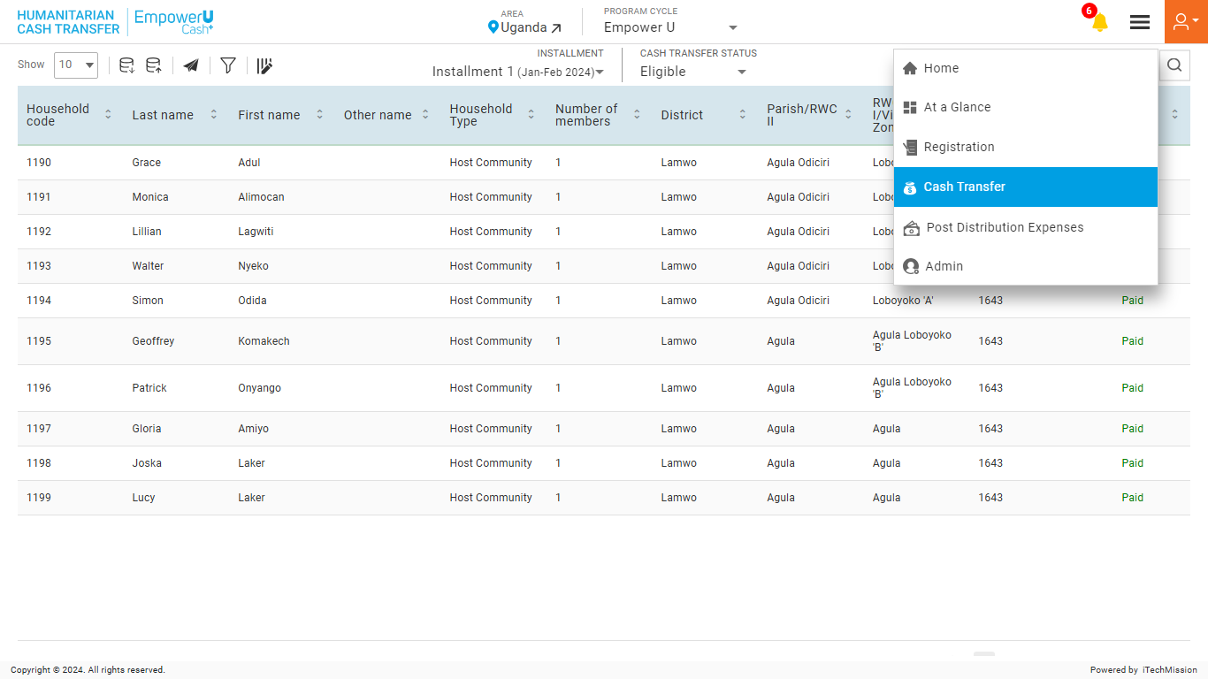
CASH TRANSFER
Navigate to the “Cash Transfer” module from the burger menu.

Slide 57
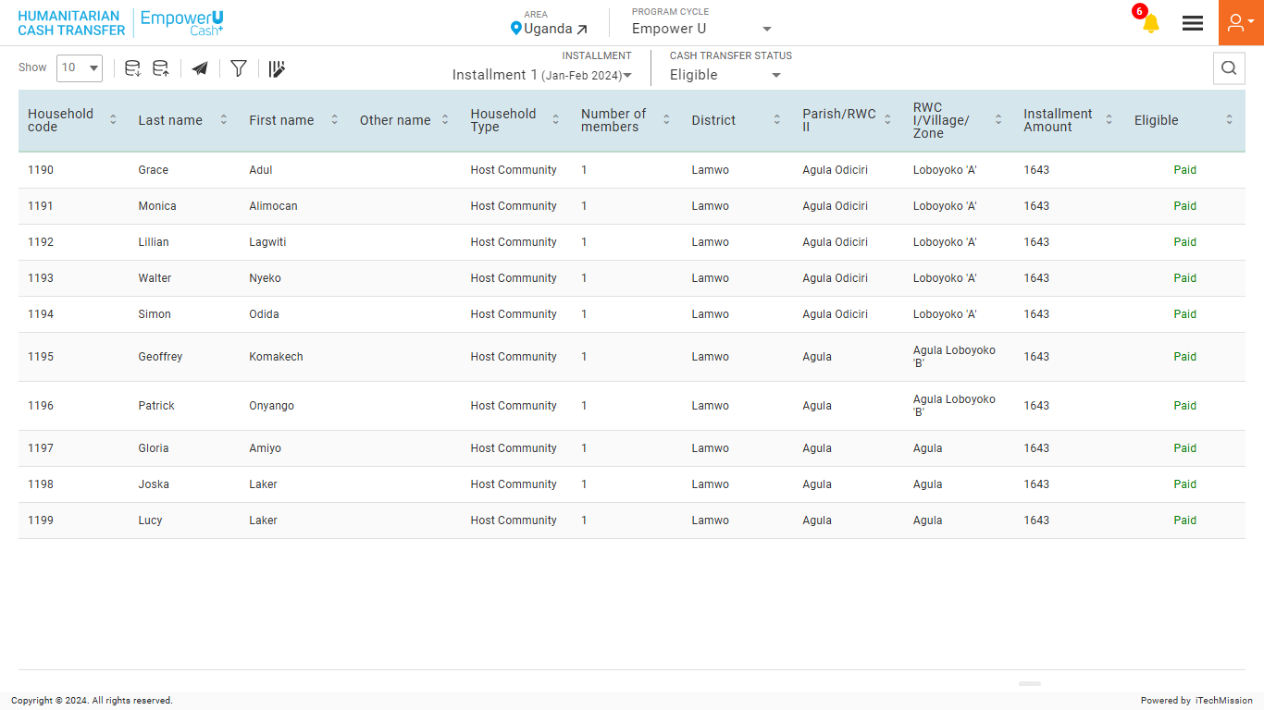
CASH TRANSFER
Select the Area to view the area-specific Cash Transfer list.

Slide 58
CASH TRANSFER
Select the Installment to view the installment-specific Cash Transfer list.

Slide 59
CASH TRANSFER
Select the Cash Transfer Status to view the status-specific Cash Transfer list.

Slide 60
CASH TRANSFER
Click on the Export button to download the existing Eligibility list.

Slide 61
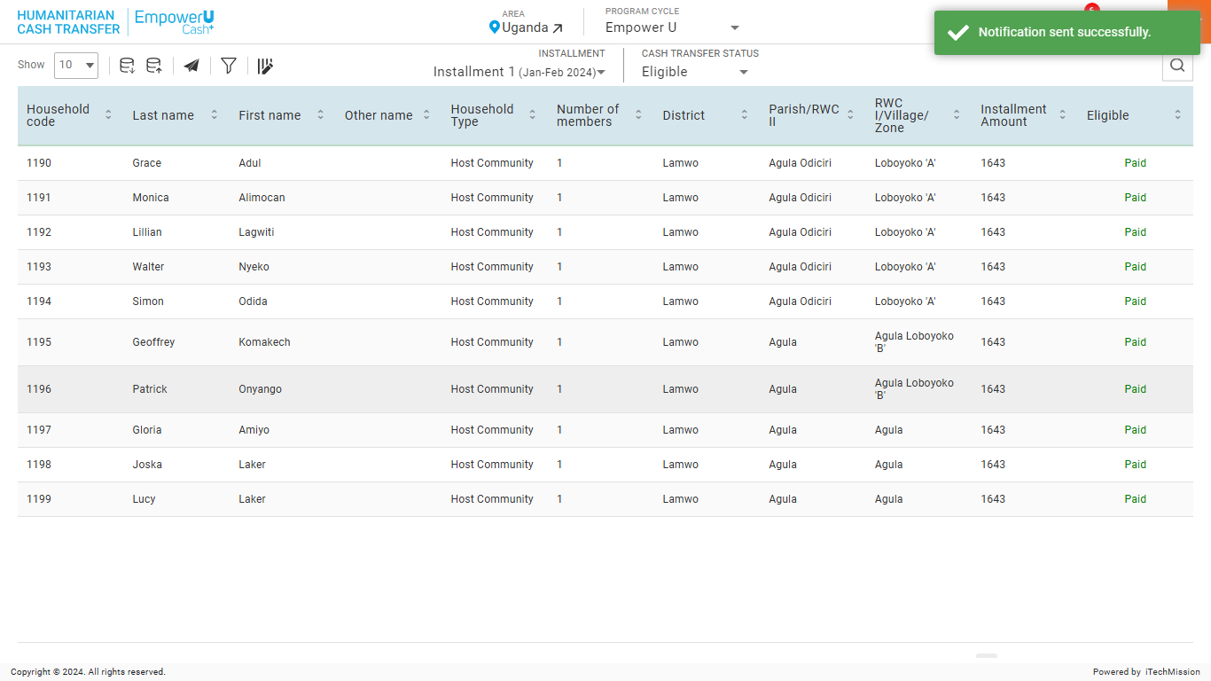
CASH TRANSFER
Click on the Send Notification button to send a notification to the respondents.

Slide 62
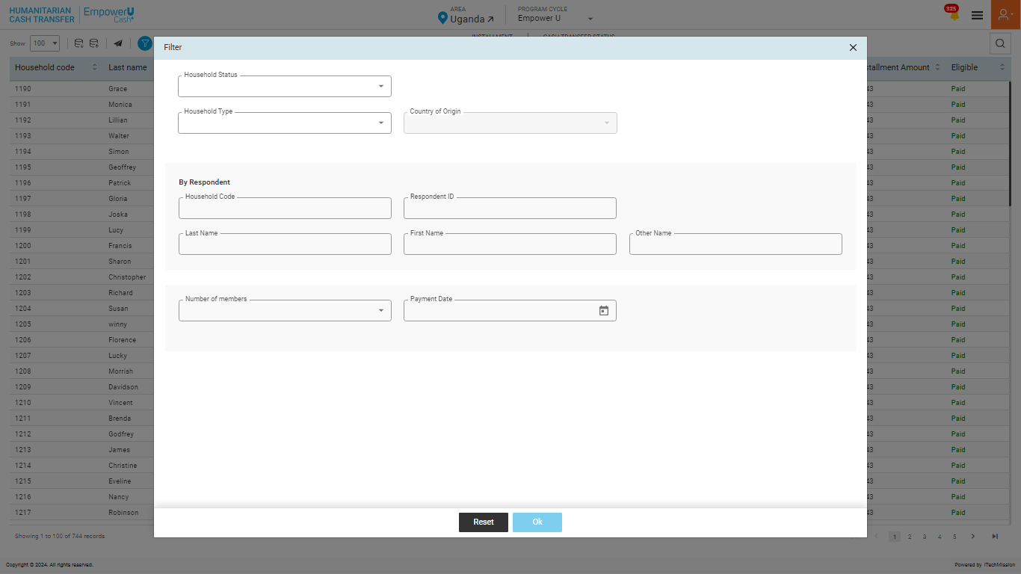
CASH TRANSFER
Filter Cash Transfer List. Click the OK button to apply.

Slide 63
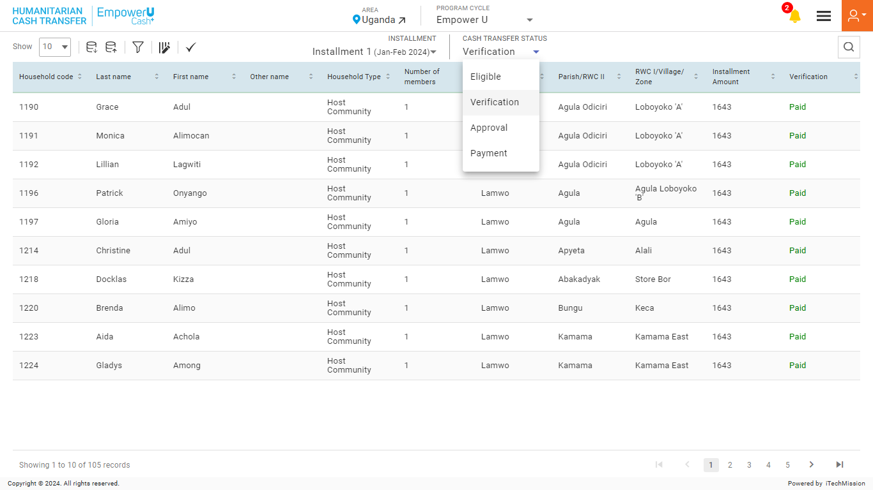
CASH TRANSFER
Select Verification to complete the verification process by the Program Coordinator.

Slide 64
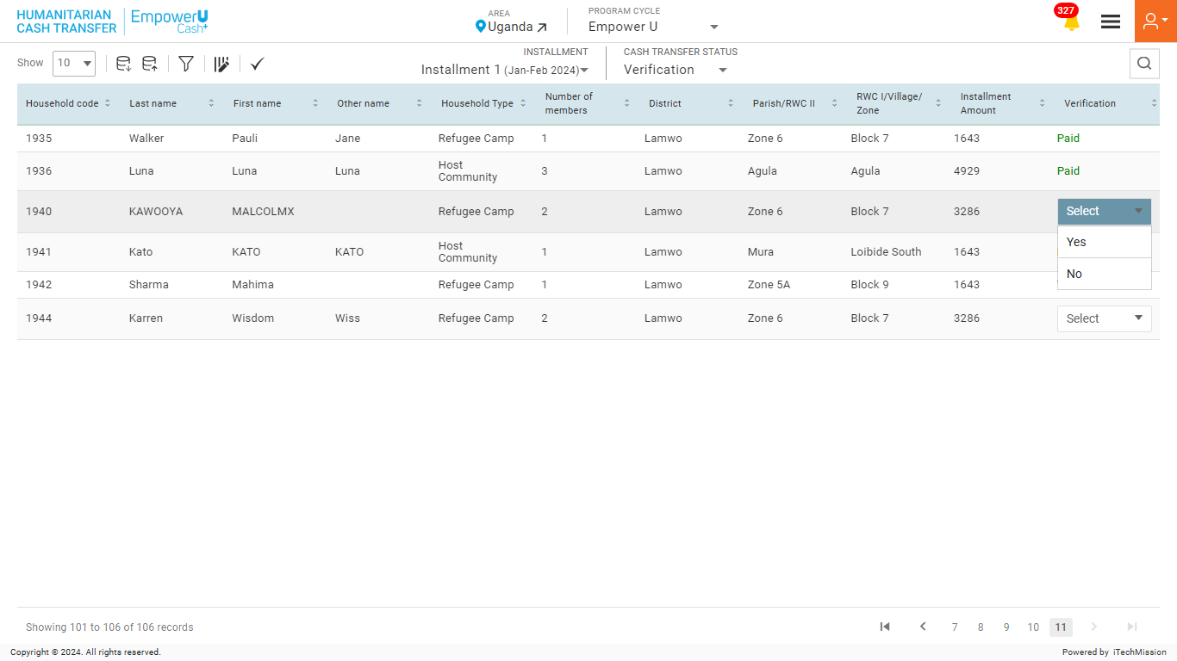
CASH TRANSFER
Verify the selected Household.

Slide 65
CASH TRANSFER
Click on the Single Tick icon to verify all the Households.

Slide 66
CASH TRANSFER
Click on the Export button to download the existing verification list.

Slide 67
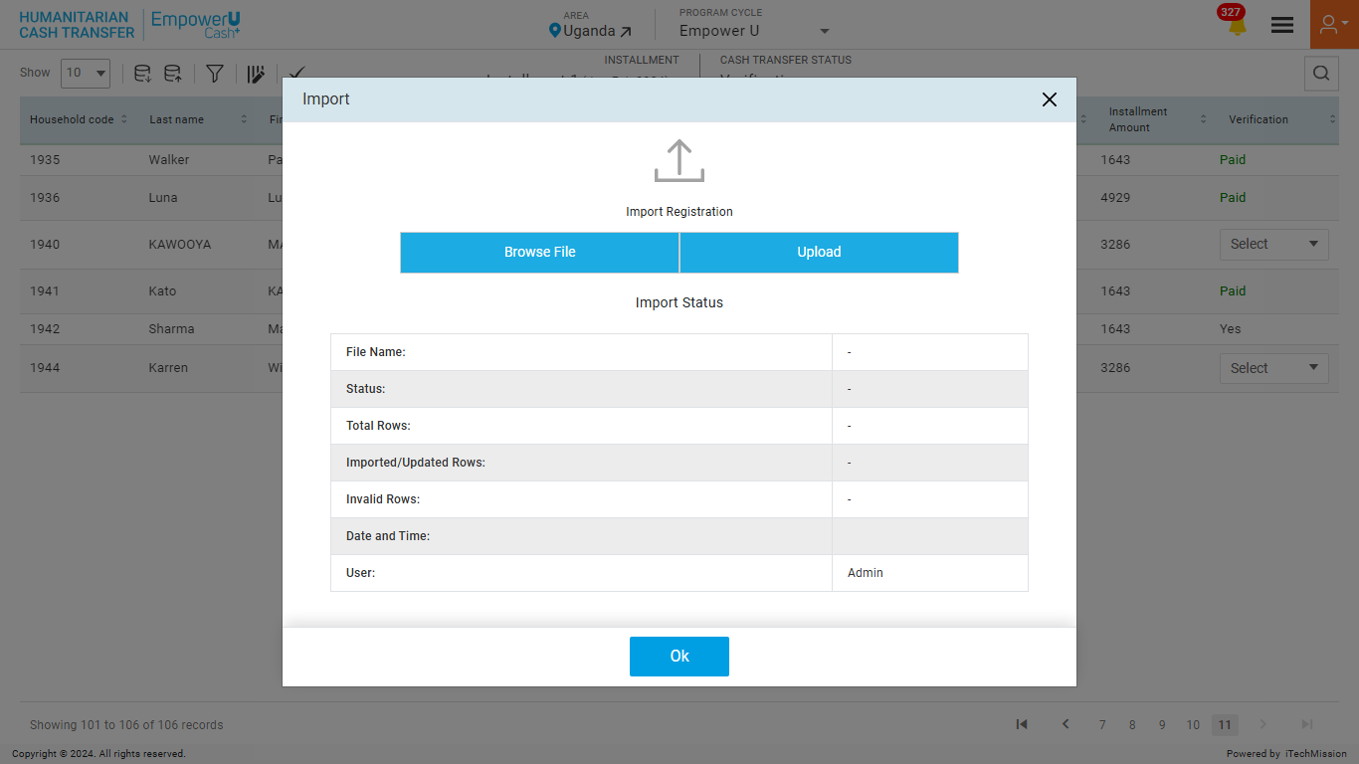
CASH TRANSFER
To import, browse the file and click the Upload button to start the import process. Click on the OK button to confirm.

Slide 68
CASH TRANSFER
View the Last Import Summary once the import process is completed.

Slide 69

CASH TRANSFER
Select Approval to complete the approval process by the Program Manager.

Slide 70
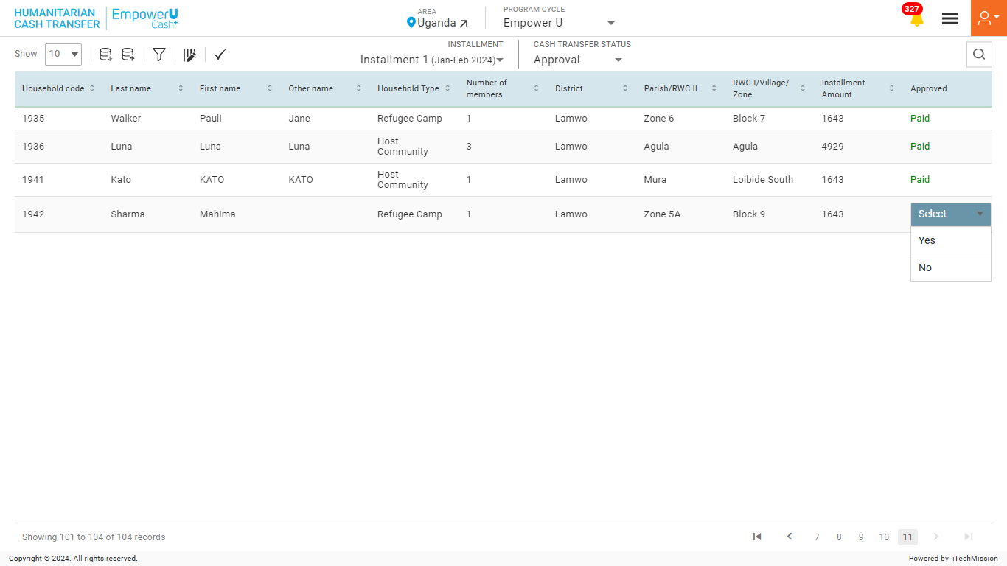
CASH TRANSFER
Approve the selected Household.

Slide 71
CASH TRANSFER
Click on the Single Tick icon to approve all the Households.

Slide 72
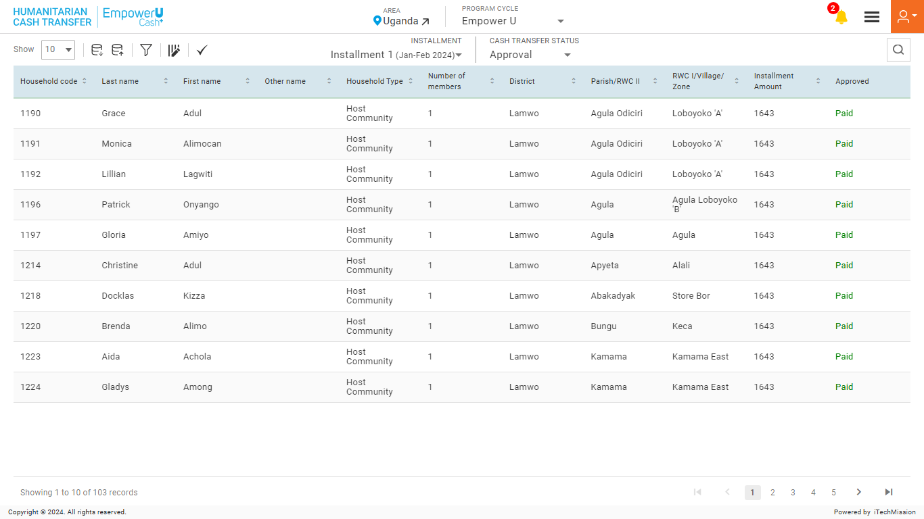
CASH TRANSFER
Click on the Export button to download the existing approval list.

Slide 73
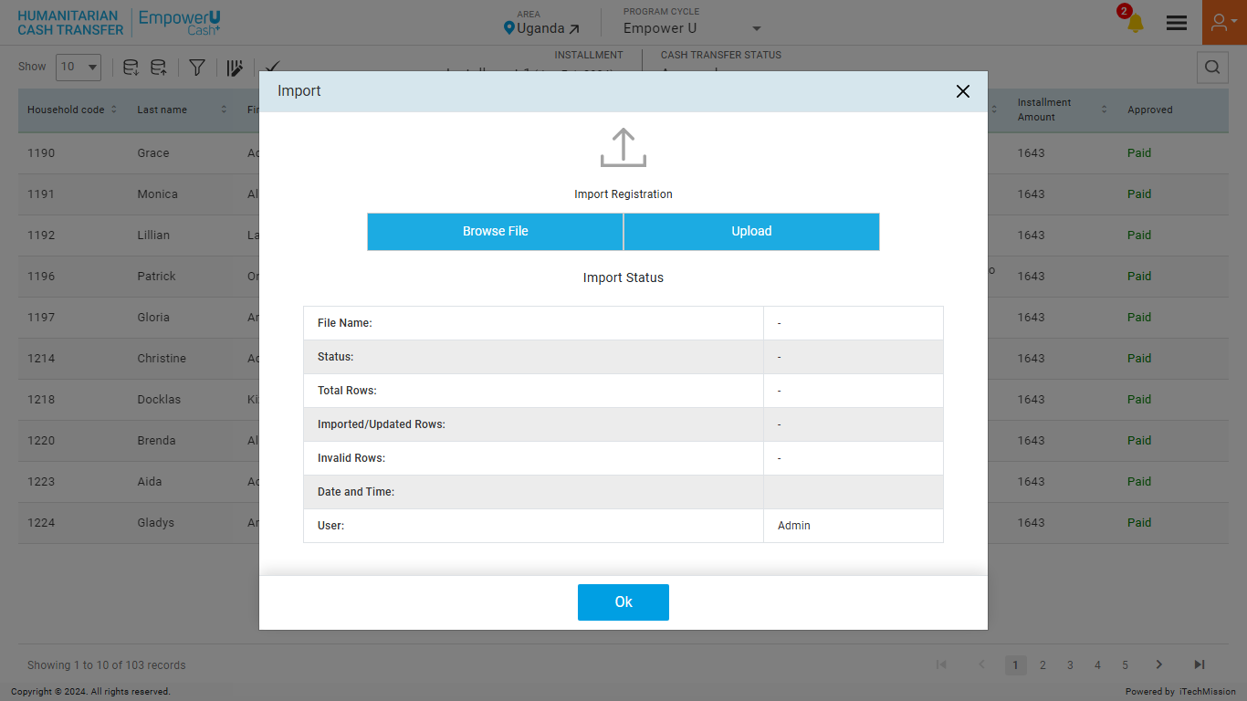
CASH TRANSFER
To import, browse the file and click the Upload button to start the import process. Click on the OK button to confirm.

Slide 74
CASH TRANSFER
View the Last Import Summary once the import process is completed.

Slide 75
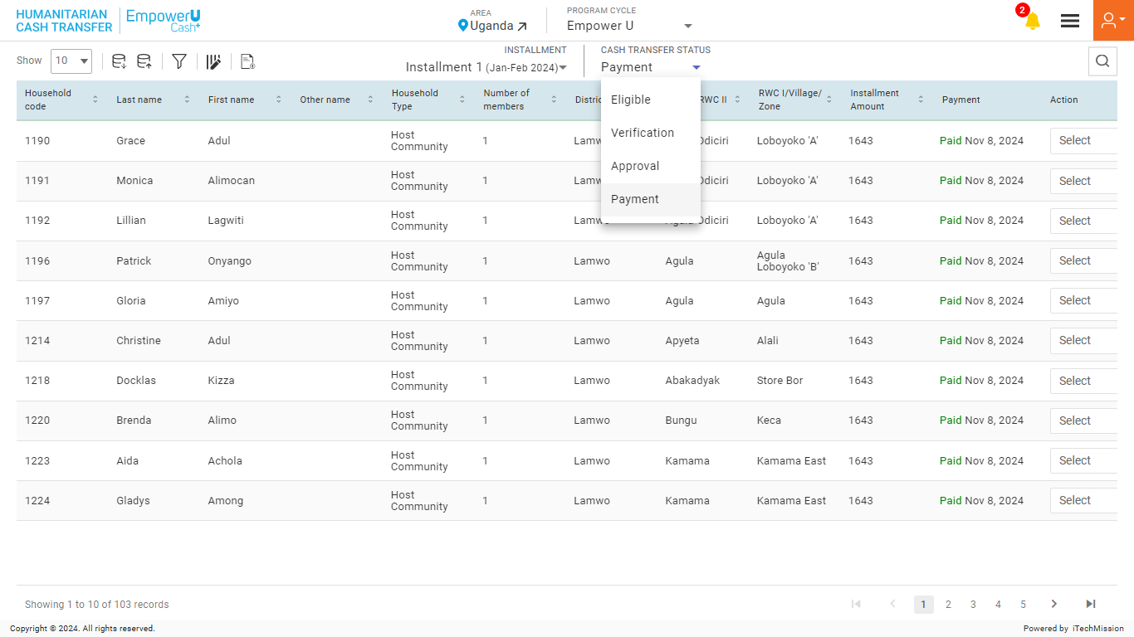
CASH TRANSFER
Select Payment to complete the payment process by the Treasury.

Slide 76
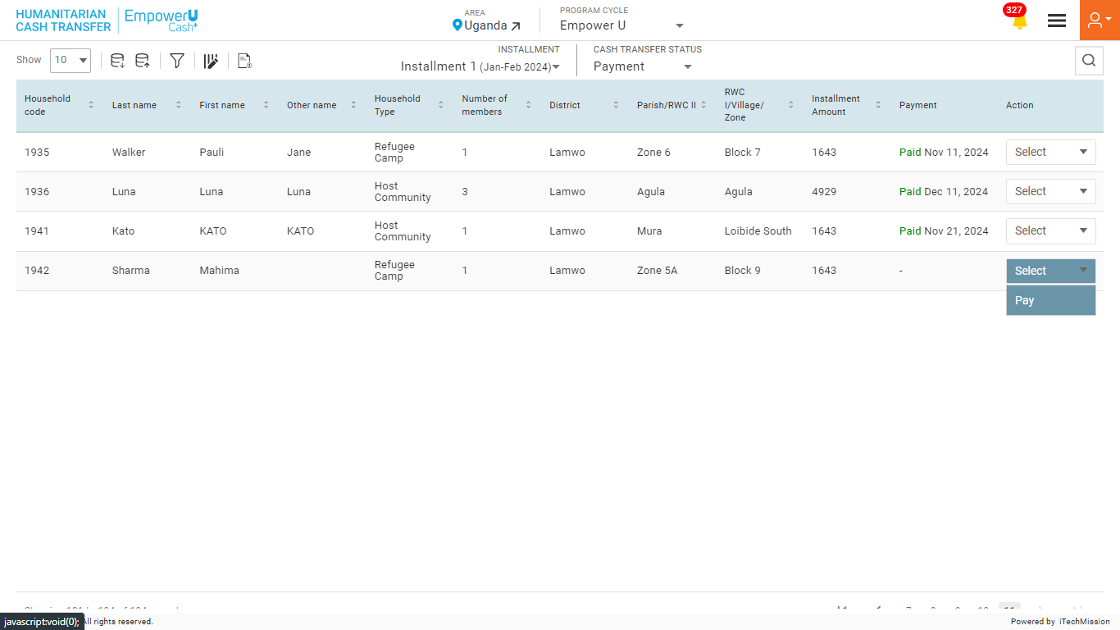
CASH TRANSFER
Click on the Bank payment list to download the respondent’s bank account details.

Slide 77
CASH TRANSFER
Click on the Pay button to enter the payment details of the selected household.

Slide 78
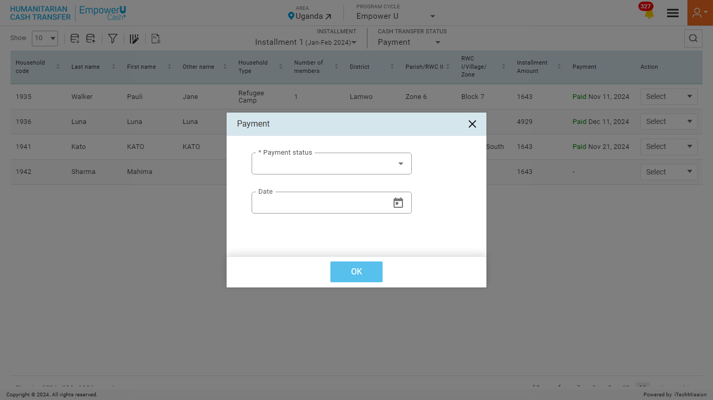
CASH TRANSFER
Enter Payment status and date. Click the OK button to confirm.

Slide 79
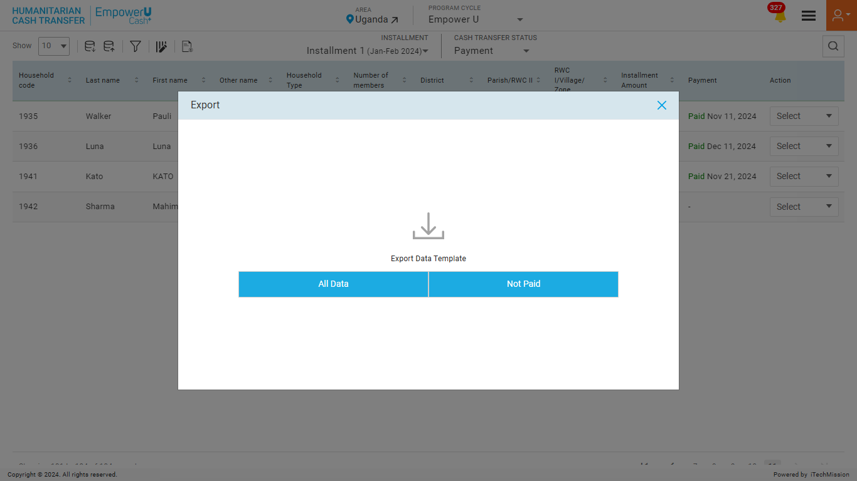
CASH TRANSFER
To export, click on Empty to download the Empty Template or click on With Data to download existing Households.

Slide 80
CASH TRANSFER
To import, browse the file and click the Upload button to start the import process. Click on the OK button to confirm.

Slide 81
CASH TRANSFER
View the Last Import Summary once the import process is completed.

Slide 82
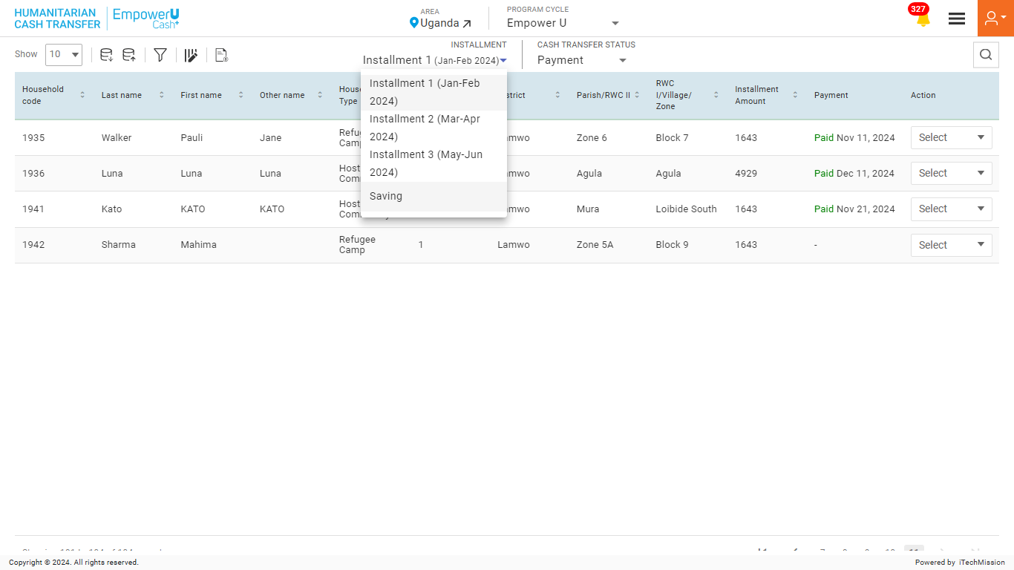
CASH TRANSFER
Complete payment for saving to add PDE for a Household.

Slide 83
LOGIN–
POST DISTRIBUTION EXPENSES
5

Slide 84
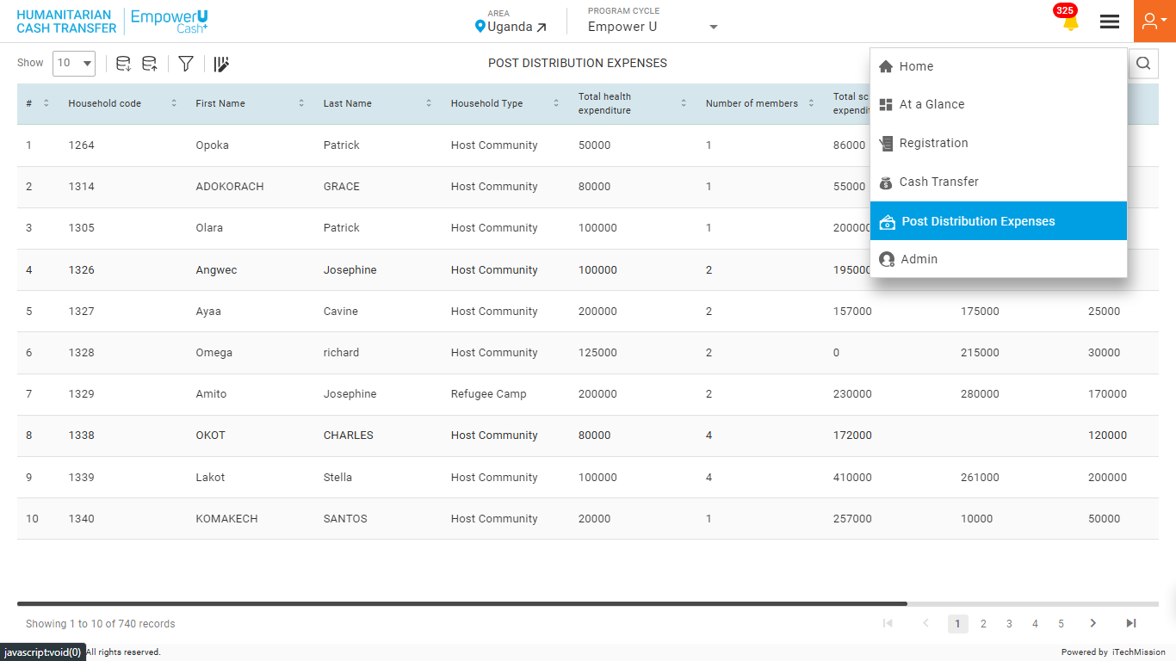
POST DISTRIBUTION EXPENSES
Navigate to the “Post Distribution Expenses” module from the burger menu.

Slide 85
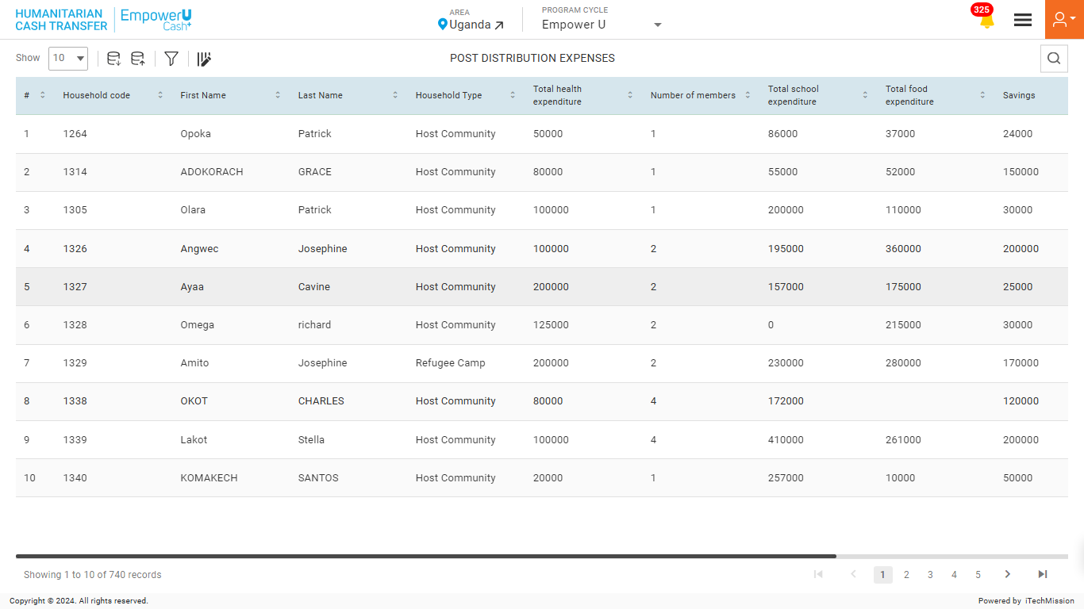
POST DISTRIBUTION EXPENSES
Select the Area to view the area-specific household list.

Slide 86
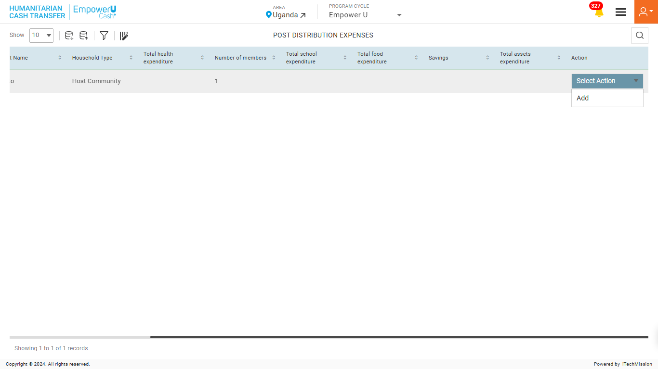
POST DISTRIBUTION EXPENSES
Click on Add button to add PDE for a Household.

Slide 87

POST DISTRIBUTION EXPENSES
Enter the mandatory details and click on Add button to confirm.

Slide 88

POST DISTRIBUTION EXPENSES
Edit the added PDE for selected household.

Slide 89

POST DISTRIBUTION EXPENSES
To export, click on Empty to download the Empty Template or click on With Data to download existing Households.

Slide 90

POST DISTRIBUTION EXPENSES
To import, browse the file and click the Upload button to start the import process. Click on the OK button to confirm.

Slide 91
POST DISTRIBUTION EXPENSES
View the Last Import Summary once the import process is completed.

Slide 92

POST DISTRIBUTION EXPENSES
Filter Cash Transfer List and click the OK button to apply.

Slide 93
5
LOGIN – ADMIN

Slide 94

ADMIN
Navigate to the “Admin” module from the burger menu.

Slide 95

ADMIN

Slide 96
5
LOGIN – ADMIN –
SUMMARY

Slide 97

SUMMARY
Navigate to the “Summary” sub-module available in the navigation panel.

Slide 98
SUMMARY
View count of Total Program cycle, Area, classification, User, and Resource.

Slide 99
5
LOGIN – ADMIN –
AREA

Slide 100

AREA
Navigate to the “Area” sub-module available in the navigation panel.

Slide 101
AREA
Click on the Plus button to add a new Area.

Slide 102

AREA
Enter the mandatory details and click on Add button to confirm.

Slide 103

AREA
To export, select the level, then click on Empty to download the Empty Template or click on With Data to download existing Households.

Slide 104

AREA
To import, browse the file and click the Upload button to start the import process.

Slide 105
AREA
View the Last Import Summary once the import process is completed.

Slide 106

AREA
View, Edit, Enable/disable, and Delete the selected Area.

Slide 107
5
LOGIN – ADMIN –
CLASSIFICATION

Slide 108

CLASSIFICATION
Navigate to the “Classification” sub-module available in the navigation panel.

Slide 109
CLASSIFICATION
Select the Classification Type and click on Plus button to add a new Classification.

Slide 110

CLASSIFICATION
Enter the mandatory details and click on the Add button to confirm.

Slide 111

CLASSIFICATION
View, Edit, Enable/Disable, and Delete the selected Classification.

Slide 112
5
LOGIN – ADMIN –
PROGRAM CYCLE

Slide 113

PROGRAM CYCLE
Navigate to the “Program Cycle” sub-module available in the navigation panel.

Slide 114

PROGRAM CYCLE
Click on the Plus button to add a new Program Cycle.

Slide 115

PROGRAM CYCLE
Enter the mandatory details and click on Add button to confirm.

Slide 116

PROGRAM CYCLE
Edit, Enable/Disable, and Delete the selected Program Cycle.

Slide 117
5
LOGIN – ADMIN –
USER

Slide 118

USER
Navigate to the “User” sub-module available in the navigation panel.

Slide 119

USER
Click on the Plus button to add a new User.

Slide 120

USER
Enter the mandatory details and click on Add button to confirm.

Slide 121

USER
View, Edit, Enable/Disable, and Delete the selected User.

Slide 122
5
LOGIN – ADMIN –
REPORT

Slide 123

REPORT
Navigate to the “Report” sub-module available in the navigation panel.

Slide 124

REPORT
Click on the Plus button to generate a new Report.

Slide 125

REPORT
Enter the mandatory details and click on Add button to confirm.

Slide 126

REPORT
Edit, Execute, and Delete the selected Report.

Slide 127

REPORT
Check Download Data and click the Yes button to execute the report.

Slide 128

REPORT
Wait until the report generation is complete. Monitor the report's status in the Download Report section.

Slide 129

REPORT
Click on the download icon to download the report and data respectively.

Slide 130
5
LOGIN – ADMIN –
RESOURCE

Slide 131

RESOURCE
Navigate to the “Resource” sub-module available in the navigation panel.

Slide 132
RESOURCE
Click on the Plus button to add a new Resource.

Slide 133

RESOURCE
Enter the mandatory details and click on Add button to confirm.

Slide 134

RESOURCE
View, Edit, Enable/Disable, and Delete the selected Resource.

Slide 135
5
LOGIN – ADMIN –
KEYFACTS

Slide 136

KEYFACTS
Navigate to the “Keyfacts” sub-module available in the navigation panel.

Slide 137
KEYFACTS
Click on the Plus button to add a new Keyfact.

Slide 138

KEYFACTS
Enter the mandatory details and click on Add button to confirm.

Slide 139

KEYFACTS
Edit, and Delete the selected Keyfact.

Slide 140
5
LOGIN – ADMIN –
IMPORT LOGS

Slide 141

IMPORT LOGS
Navigate to the “Import Logs” sub-module available in the navigation panel.

Slide 142

IMPORT LOGS
Download, and Delete the selected Log.

Slide 143


